Slide 1

Code of Car Service Rules and Interpretations - Freight:
Car Service Rules 1 through 6
Presented by:
JoAnne Miner
Director

Slide 2

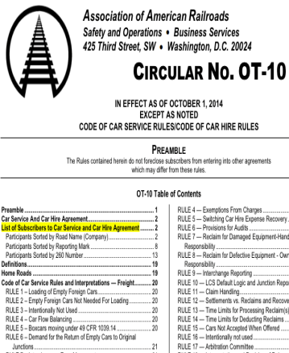
Car Service Rules
RULE 1 – LOADING OF EMPTY FOREIGN CARS
RULE 2 – EMPTY FOREIGN CARS NOT NEEDED FOR LOADING
RULE 3 – INTENTIONALLY NOT USED
RULE 4 – CAR FLOW BALANCING
RULE 5 – BOXCARS MOVING UNDER 49 CFR 1039.14
RULE 6 – DEMAND FOR THE RETURN OF EMPTY CARS TO THE ORIGINAL JUNCTION

Slide 3
LOADING OF EMPTY FOREIGN CARS
1
Unless covered by a Car Service order or directive, or moving under the optional empty mileage charge provision of 49 CFR 1039.14 (c)(1)(i) as provided in Car Service Rule 5, foreign cars may be loaded without regard to route or destination.

Slide 4


SCOPE and PURPOSE
Maximize the General Service and Unassigned Fleet of box cars, gondolas, and flat cars
Eliminate the potential bottleneck in seeking permission from equipment owner

Slide 5

2
EMPTY FOREIGN CARS NOT NEEDED FOR LOADING
– Handling of Cars
Notification of Intention to Store Cars
Definition of Junction

Slide 6
RULE 2 – Empty Foreign Cars Not Needed For Loading
Handling of Cars: Unless covered by a Car Service order or directive, foreign cars not needed for loading must have doors closed and may be:
  Delivered to the home road at any junction, subject to Rule 6.
  Forwarded to the road (including the haulage rights carrier-tenant) from which originally received under load, at the junction where received, except that when handled in road haul service, cars of direct connection ownership may not be delivered empty to a road which does not have a direct connection with the car owner. If the junction where received under load is also a junction with the car owner, the car must be delivered to the owner at that junction.
  Returned to the delivering road (including the haulage rights carrier-tenant) when handled only in switching service, unless at a junction with the home road.
  Stored (applies only to boxcars, as authorized in 49 CFR 1039.14 (c)(1)(ii), that are not moving under empty mileage charges).

Slide 7
RULE 2 – Empty Foreign Cars Not Needed For Loading
(continued)
Notification of Intention to Store Cars: The holding railroad must notify the Car Service Officer of the owning railroad of its intention to store cars under the provisions of this rule. Notification must:
  Be transmitted by midnight of the third day after cars were released from inbound load or received at initial storage or loading point in one of the following manners:
      TRAIN II message, or
      by telephone confirmed in writing.
  Include the initial and number of individual cars.
  Include the date and location cars were released empty or received at initial storage point.

Slide 8
RULE 2 – Empty Foreign Cars Not Needed For Loading
(continued)
Definition of Junction: “Junction” as used in this rule means stations where roads interchange cars at a common point or within switching limits over their own lines, or an intermediate line or lines, or a car ferry or float within such limits. Roads so interchanging cars shall be considered direct connections.
  This information should be registered in the Industry Reference Junction and Interchange File and when the interchange is other than over their own rails, the channel through which the interchange is effected must be shown.

Slide 9

INTENTIONALLY NOT USED
3
RULE AVAILABLE: SEE AAR TO PUT YOUR RULE HERE

Slide 10
CAR FLOW BALANCING
4
Upon request by a railroad, the Business Services Division of the A.A.R. may direct and administer a car-flow balancing system between that railroad and other railroads which have agreed to such a system covering cars of their respective ownerships.

Slide 11
To allow a railroad to enter into multi-lateral car flow balancing agreements
Allows for central voluntary administration by AAR for flowing empty freight cars owned by the participants under a predetermined formula to balance car supply
CAR FLOW BALANCING – SCOPE AND PURPOSE

Slide 12
5
BOXCARS MOVING UNDER 49 CFR 1039.14
Empty boxcars moved at the request of the owner, ICC or AAR under the provision of 49 CFR 1039.14 (c)(1)(i) may be subject to the optional charge per mile as authorized therein.

Slide 13
RULE 5
SCOPE
To protect railroads moving empty boxcars at the request of the car owner, STB, or AAR
PURPOSE
Unless a railroad has its own tariff for handling empty freight cars, it may choose to charge the US dollar amount specified in the rule ($.44 per mile, updated regularly in Circular OT-10) for cars moving out of their service route.

Slide 14
DEMAND FOR THE RETURN OF EMPTY CARS TO ORIGINAL JUNCTIONS
6
COLABORATION OF CAR SERVICE OFFICERS

Slide 15
Rule 6 - - as written
A home road may demand the return of empty cars at the junction where delivered under load if the movement of traffic (movement regularly through a junction point utilizing the same equipment type and, if applicable, car grade) requires such return. However, cars offered to a home road for repairs, in accordance with the Mechanical Interchange Rules, must be accepted by owners at any junction point. The Car Service Officer of the home road must notify the Car Service Officer of the receiving road specifying the equipment type codes, car grades (if applicable) and particular junctions involved.

Slide 16
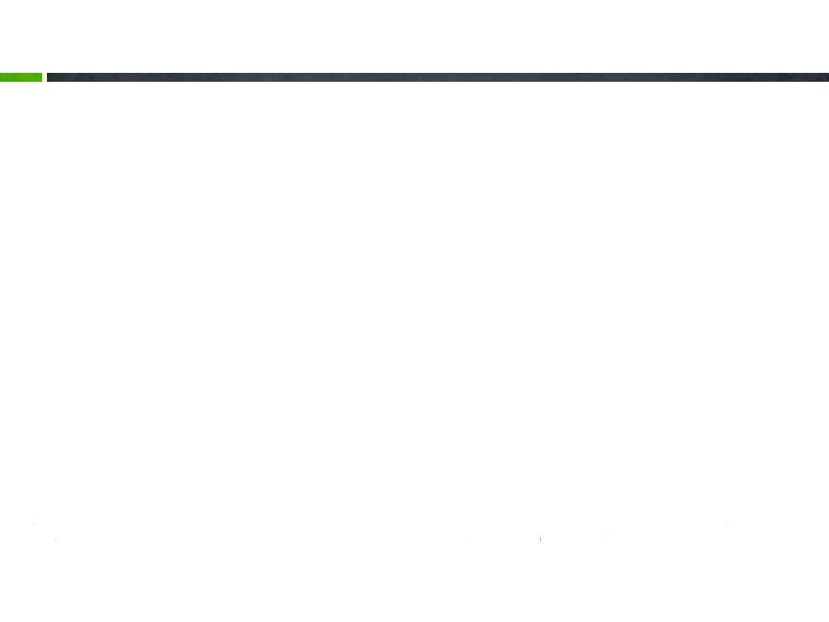
RULE 6
SCOPE
PURPOSE
The rule is most generally used to keep an expected volume of traffic moving in defined service paths
Allows a railroad to plan for return of freight cars at a specified junction. Cannot be invoked for bad order cars returning home for repairs

Slide 17

QUESTIONS

Slide 18
THANK YOU
Presented by:
JoAnne Miner
Director

