Slide 1
EAC Update for ACACSO May 2015
Dale Cassels – Manager Car Accounting
CSX Transportation

Slide 2
EAC Meetings Held & Scheduled
Recently Held EAC Meetings:
January 2015 – Conference Call
April 15, 2015 in Cary, NC hosted by RailInc
Future EAC Meetings:
October 14, 2015 in Jacksonville, FL hosted by The Genesee & Wyoming
January 2016 – Conference Call
April 20, 2016 in Montreal hosted by the CN

Slide 3
EAC Committee Chairs
George Jones (CSX) – EAC Chair 2014-2015
Paddy O’Neill (NS) – Voted Vice Chair of EAC
BNSF nominated O’Neill as Vice Chair and Greenbrier Seconded the motion and passed by a unanimous vote in the Jan 2015 meeting
Paddy O’Neill will become Chair in Jan 2016

Slide 4
EAC - Task Forces and Chairs
Car Hire Rate Process & Procedures – Joan O’Brien (First Union)
Car Hire Calculation – Elan Neal (GNWR)
Car Service – Ken Jacobs (BNSF)
Training – Todd Poland (Watco)

Slide 5
EAC Goals for 2015
Continue to improve asset utilization to gain maximum car loads and improve fluidity with the industry fleet.
Continue to evaluate and implement the road map toward centralized car hire processing.
Support railroad industry for car service and car hire training promoting efficient operations and improved data flow for railroad equipment.
Increase compliance with OT-5 requirements to request loading authority for privately owned cars.

Slide 6
2015 RailInc Application Enhancements
Rule 5 TOL Correction Process
User interface enhancements were implemented in February
Tank Car Mileage Equalization
Carriers can enter comments
Include comments on adjustment emails
Search by paying Mark and Car Initial
CASS
90 Day Quick Search was added

Slide 7
2015 RailInc Application Enhancements
Mainframe Migration
Mark Hawkins with update on Thursday
CHDX
Migration out of Flex
Duplicate data edits
Car Hire Calculation Task Force to assist Railinc
Rule 4 TOL Process
Correctly assign liability from month to month

Slide 8
Equipment Quality Reporting (EQR) TAG
Changes to OT-34
Enhance the visibility of the Shipper Reject Codes
The use of EQR to report shipper rejects becomes mandatory
Changes to Car Hire Rule 1 have been made to support
Notes:
Jim Pinson will report more on this Friday morning.

Slide 9
Subjects of Interest
Training Update – JoAnne Miner(ShipXpress)
Washington Update – Jeff Usher(AAR)
SCO90 Update – Jeff Roton(NS)
Appendix S Review
Changes effective on July 1, 2015
Car Hire Rule 25
BNSF proposed to review the rule
Specifically, the appropriate handling for situations where one party does not participate in the negotiation process and does not provide a BFO when requested

Slide 10
2016 EAC Sponsored Projects
Submitted to RPSWC:
Ramp-Ed Enhancements
Mark Management Project
EOT Centralization
Market Data Report Enhancements
OT-5 Enhance

Slide 11
Proposed OT-5 Enhancements
Loading applications should be closed once approved by origin carrier
Cars submitted on an application should be verified in Umler
Cars submitted on an application should be checked against the Damaged & Defective Car Tracking (DDCT) system
The Serving Carrier Reciprocal Switch (SCRS) file should be used to edit the shipper information (CIF) included on the application

Slide 12
New Proposals/Ideas for EAC?

Slide 13
RAILINC DDCT Value Quantification
Equipment Assets
Committee Meeting
April 15, 2015

Slide 14
Overview of Damage Defective Car Tracking (DDCT) valuation results.
Review the methodology utilized
Share the DDCT valuation analysis
Summarize key components of the analysis

Slide 15
Value methodology used hard data, estimates, and extrapolation for non-available data to validate directionally correct ROI.
Railroad Perspective | Actual | Business Cases | Variance (Fav/(Unfav)) | Directionally Correct
Value (Benefits – Costs) | Calculated | Calculate | Calculated | Yes / No
Benefits | Input from RR and Railinc: -Hard data & estimates Extrapolation: -Non-available data | As stated | Actual – Business Case
Costs | Input from RR and Railinc: -Hard data & estimates Extrapolation: -Non-available data | As Stated | Actual – Business Case
ROI | Calculated | Calculated | Calculated | Yes / No

Slide 16
DDCT improves coordination for better equipment management, improved rail safety and reduced administrative costs.
Equipment management & safety
Quicker decision about repairing or scrapping equipment
Streamline car hire process
Information more visible and accessible for all parties involved
Reduced administrative costs
Create paperless defect cards (no brackets)
Single-source system reduces effort needed to maintain good data
Reduced reclaim billings

Slide 17
The value of DDCT realized over five years is $45 million, more than directionally correct.
Railroad Perspective | Actual | Business Cases | Variance (Fav/(Unfav)) | Directionally Correct
Value (Benefits – Costs) | $45.4M | $1.3M | $44.1M | Yes / No
Benefits | $54.8M | $10.6M | $44.2M
Costs | $9.4M | $9.3M | ($0.1M)
ROI | 481% | 14% | 467% | Yes / No

Slide 18
Several benefits and costs were listed in the business case.
Benefits | Costs
Speed of Repair Defect bracket savings Reduction in reclaims Reduction in Car Accounting Labor Reduction in Car Hire Expense Others | Railinc billings (actual) Railroad development costs (as stated in business case)

Slide 19
Speed of Repair: Having a centralized electronic data source has reduced the time to close an incident, increasing rail car utilization.
Type of Benefit: Increased revenue
Quantification Approach: Used actual data showing decrease in the days a car is out of service, applied additional days of service to the average revenue per car and discounted for potential non-revenue generating cars.
Railroad Perspective | Actual | Business Case | Variance (Fav/(Unfav)) | Directionally Correct
Speed of Repair | $45.8M | $0.0M | $45.8M | Yes / No

Slide 20
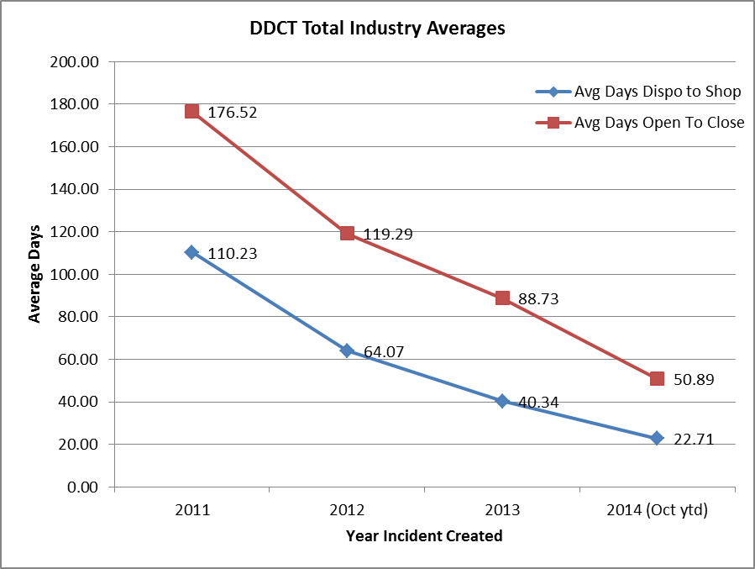
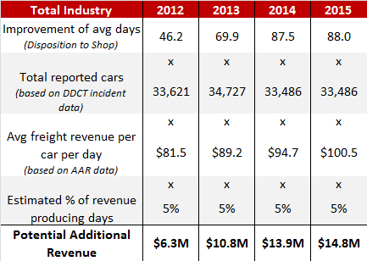
DDCT has reduced the time for communicating and dispositioning incidents and increased the availability of rail cars for generating revenue.
Includes Rule 1 Minor Defects , Rule 107 Major Damage , and Rule 108 Major Defects

Slide 21
Defect Card Bracket Savings: Less than anticipated due to little data to support original estimates; however defect brackets have been eliminated.
Type of Benefit: Cost reduction
Quantification Approach: Actual data confirmed elimination of card bracket repairs. Used average costs in previous 5 years, adjusted for inflation to compute savings.
Railroad Perspective | Actual | Business Case | Variance (Fav/(Unfav)) | Directionally Correct
Defect Card Bracket Savings | $1.6M | $3.6M | ($2.0M) | Yes / No

Slide 22
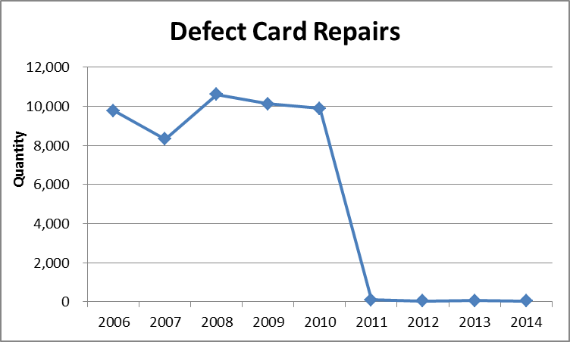
Defect Card Bracket repairs are eliminated.

Slide 23
Other Benefits: Reclaim data shows that significant reduced reclaims have validated the administrative cost reductions reported by the industry.
Type of Benefit: Cost Reduction/Cost Avoidance
Reduction in reclaims, Car Accounting labor, Car Hire Administrative expenses
Quantification Approach: Benefits listed by the industry were included as reported. Additional savings could be extrapolated to non-reporting roads with further research.
Railroad Perspective | Actual | Business Case | Variance (Fav/(Unfav)) | Directionally Correct
Others | $7.4M | $7.0M | $0.4M | Yes / No

Slide 24
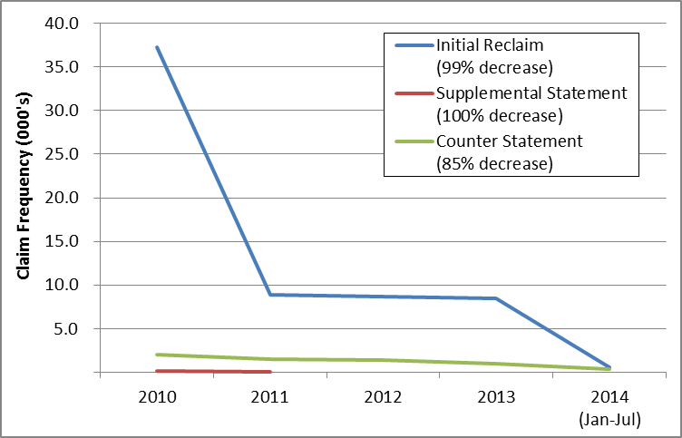
Car Hire Data Exchange data validates reduced reclaims and counter reclaims, which should result in lower administrative costs.

Slide 25
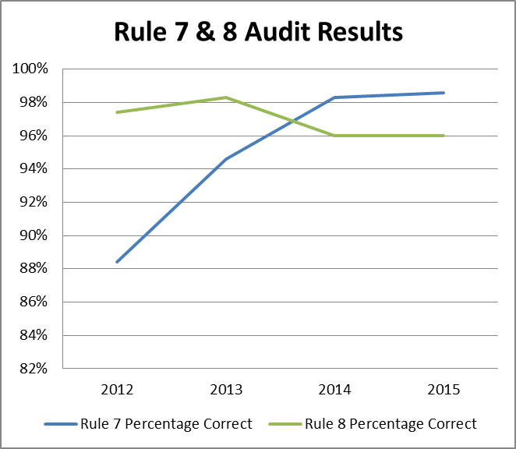
Car hire audit results support reduction in reclaims across the industry.
AAR Car Hire Audits between 2012 - 2014
Statistically significant random sample
DDCT allocates Car Hire correctly in almost all cases

Slide 26
Additional RPSWC industry projects will be evaluated in 2015
Valuation will use similar methodology
Work with project sponsors to define metrics as part of the project process

