Slide 1
Car Hire Fundamentals
ACACSO
San Antonio, TX
May 9 – 11, 2018

Slide 2
Everything Works Earned Month Jan 2018
ABDC 123456
Built in 2017, registered & available for use in January 2018
→ Car Owner receives full 744 hours as reported by RRs
Partial details reported by reporting Railroads:
January = 31 Days
31 days x 24 hours/day = 744 hours

Slide 3
Short 48 Hours Earned Month Oct 2017
GOEM 598435
Car Owner receives 696 hours for 744 hour month
October = 31 Days
31 days x 24 hours/day = 744 hours
Our records indicate missing 48 Hours of Car Hire
Due from Hour 38 to Hour 86
48 Hours x $0.85 / Hour = $40.80 Car Hire due Car Owner

Slide 4
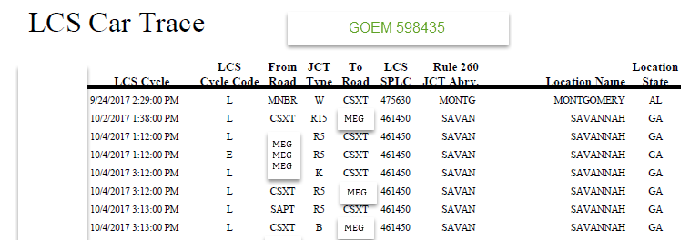
Short 48 Hours Earned Month Oct 2017 Next Step
Verify LCS Messages for Car Hire Liability
LCS verifies a Rule 15 TOL to road MEG From hour 38 to hour 86
MEG did not pay the 48 hours in current or voluntary month
Because Car Hire due Car Owner is over $25 a claim needs to be generated

Slide 5
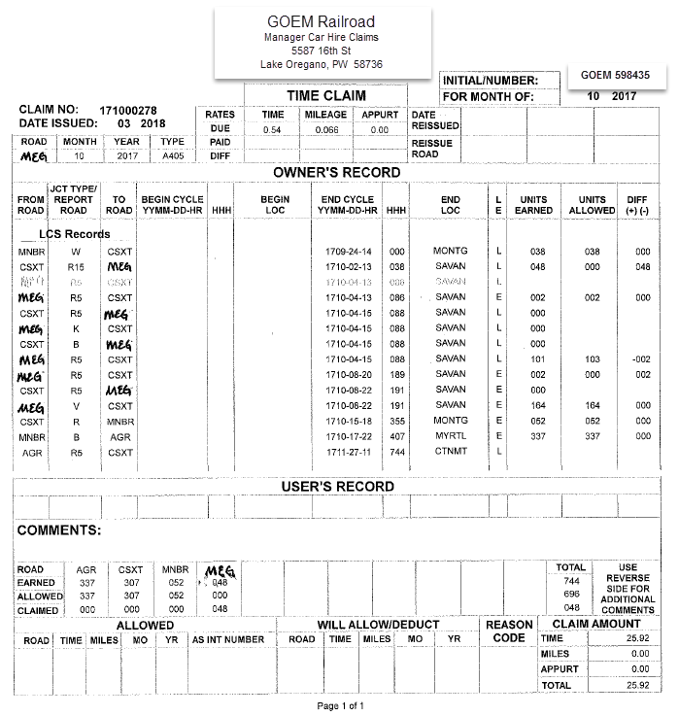
Sample Claim Format

Slide 6
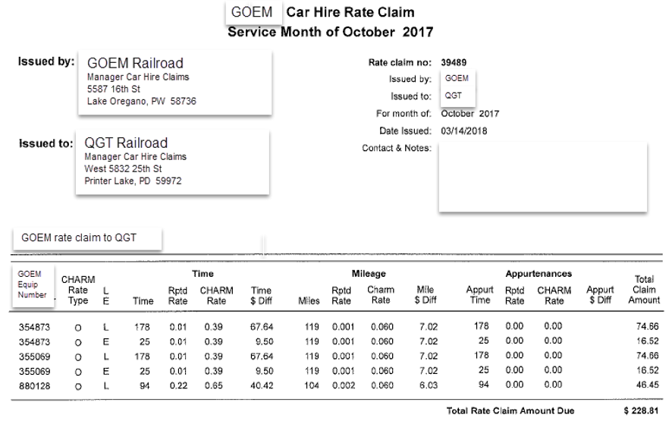
Claims
Receiving road has 60 days from the postmark to respond to the claim
Pay
Pay Partial Amount
Decline – With valid reason
Rate Claims
Compare rate reported to rate you believe should have been paid
Generate Rate Claim if sum of reported cycles totals $25 or more
→ Can be side agreements received by one party but not by the other
→ Empty & Loaded rates can be different

Slide 7
Reclaims Taken That Works – Earned Month Jan 2018
Part of validating reclaims is determining if Car Hire is paid during the time when the reclaims are being taken
Do you have an agreement for the reclaim?
Special Agreements on file – Must be approved by both roads
Car Hire Rule 22 – No prior approval needed, Part of Car Hire Rules
GOEM 494500 is eligible for Car Hire Rule 22 Reclaims.
Account Code 010 = Car Hire Paid for Railroad Equipment
Account Code 222 = Rule 22 Reclaim at loading point
Account Code 224 = Rule 22 Reclaim held short of loading point Greater than 24 hrs

Slide 8
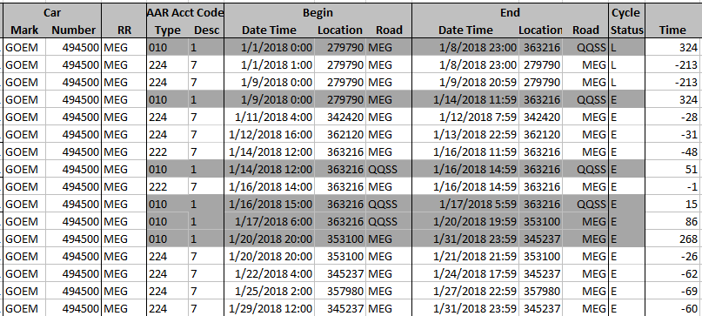
Reclaims Taken That Works – Earned Month Jan 2018
GOEM 494500
Car Hire Paid by road MEG for the month (shading)
Review timing of Reclaims
For 224, Make sure they are for 24+ hours
For 222, Make sure the car is at loading point

Slide 9
Reclaims Taken That Don’t Work – Earned Month Jan 2018
BRAN 568741
Car received by MEG, pays Car Hire
They put a reclaim onto the car stating the car is in “Storage”
When researching our agreements on file
→ We find no active storage agreement in place with road MEG
The reclaim needs to be countered

