Slide 1
“Carhire from a non-car owners perspective”
Inpr-wtjr-nogc-ncrc
Linda iverson

Slide 2
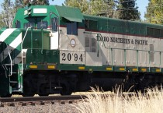
Idaho northern & pacific railroad

Slide 3
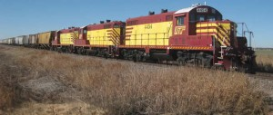
Wichita, tillman & Jackson railway

Slide 4
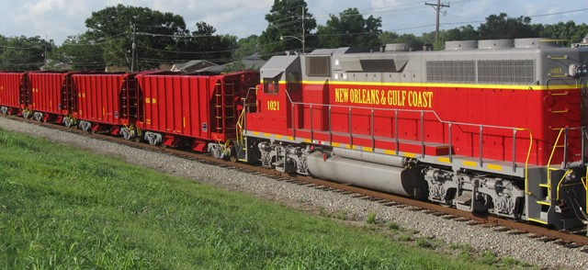
New Orleans & gulf coast railway

Slide 5
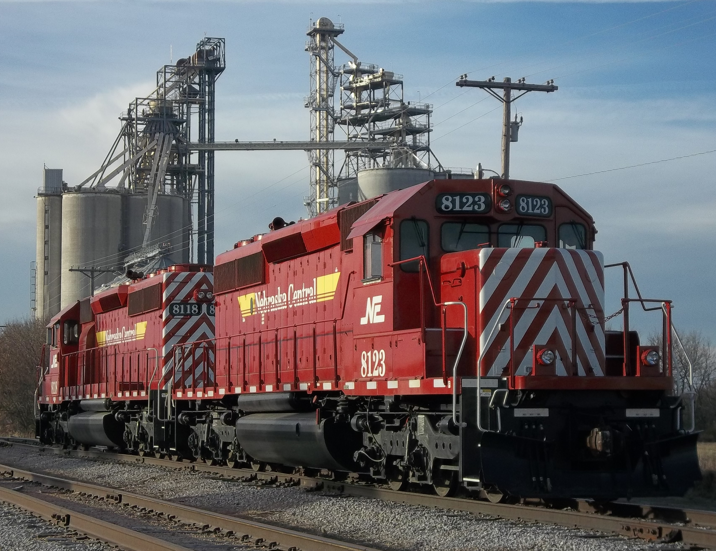
Nebraska Central railroad

