Slide 1
Car Hire Rate Negotiation Self-Service (CHRNSS)
Sara Maples
ACACSO
May 14, 2015

Slide 2
Car Hire Rate Negotiation Self-Service 2015 Release Highlights
Car Hire Rule 1 update – zero rating changes
Car Hire Rule 1.H 3 – 18-month rule
Notes:
Highlights of 2015 Release
Car Hire Rule 1.B.2 within Circular OT-10 states that cars assigned with Transportation Codes S, X, or Y will have a rate of zero assigned in the system.
A Railinc internal audit revealed issues with the application of Car Hire Rule 1.H.3 (The 18 month rule). This release ensures that default rates are re-set correctly when cars come into service 18 months or more after the initial default rate is assigned. Research is underway at Railinc to identify any default rates that were not re-set as required by Car Hire Rule 1.H.3. Car mark owners will be advised of any changes in default rates. Preliminary research indicates that there will be few, if any, rates that need to be re-set. These changes will go into effect on May 1, 2015.

Slide 3
Car Hire Rate Negotiation Self-Service Upcoming 2015 Release Highlights
Dashboard Optimization
Notes:
Highlights of project release 2

Slide 4
Car Hire Rate Negotiation Self-Service
Railinc’s Car Hire Rate Negotiation Self-Service (CHRNSS) application provides users with a convenient, single access point where they can participate in negotiations related to car hire, the amount of money paid for the use of a railcar.
Notes:
CHRNSS provides users with a single access point where they can participate in negotiations related to car hire, or the compensation paid by a user to an owner for the use of a railcar. CHRNSS enables users to transition from legacy in-house deprescription bid-and-offer systems to a centralized, Railinc-supported solution.
Through features like a detailed bid-and-offer dashboard, CHRNSS lessens the administrative effort required to participate in bid-and-offer negotiations, streamlining operations and leading to cost reductions. Because Railinc supports this solution, users also can avoid replacement and/or upgrade development costs associated with their in-house systems. Users can receive immediate feedback during the bid-creation process, and upload or download a list of equipment into the bid-and-offer system. Railinc decommission the deprescription application in March 2013.

Slide 5
Benefits and Capabilities
Cost Savings: CHRNSS enables users to transition from legacy in-house deprescription bid-and-offer systems to a centralized, Railinc-supported solution. Because Railinc supports this solution, users can avoid replacement and/or upgrade development costs associated with their in-house systems.
Productivity: Through features like a detailed bid-and-offer dashboard, CHRNSS lessens the administrative effort required to participate in bid-and-offer negotiations, streamlining operations and improving productivity.
Improved Decisions: CHRNSS provides specific information about car type and characteristics. This helps users better define the types of cars they need, car owners better segment their cars during the rate negotiation process and bid recipients quickly validate that the offered cars meet their expectations
Convenience: With CHRNSS, users have a single point of access where they can manage and participate in the bid-and-offer negotiation process.
Notes:
CHRNSS provides users with a single access point where they can participate in negotiations related to car hire, or the compensation paid by a user to an owner for the use of a railcar, and ensure that the needs of lessees match with the characteristics of available railcars. The primary benefits of CHRNSS are:
Convenience: With CHRNSS, users have a single point of access where they can manage and participate in the bid-and-offer negotiation process.
Productivity: Through features like a detailed bid-and-offer dashboard, CHRNSS lessens the administrative effort required to participate in bid-and-offer negotiations, streamlining operations and improving productivity.
Cost Savings: CHRNSS enables users to transition from legacy in-house deprescription bid-and-offer systems to a centralized, Railinc-supported solution. Because Railinc supports this solution, users can avoid replacement and/or upgrade development costs associated with their in-house systems.
Improved Decisions: CHRNSS provides specific information about car type and characteristics. This helps users better define the types of cars they need, car owners better segment their cars during the rate negotiation process and bid recipients quickly validate that the offered cars meet their expectations.

Slide 6
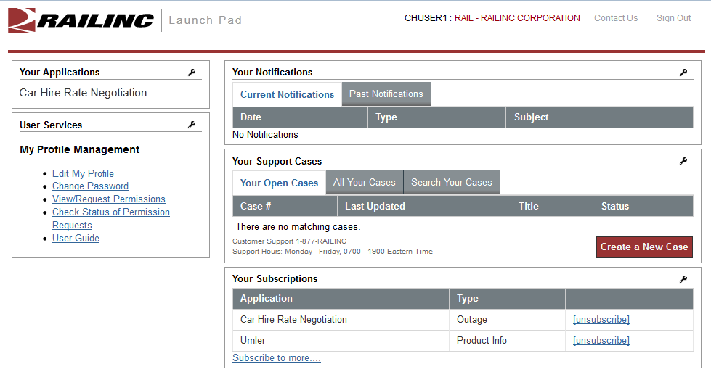
Car Hire Rate Negotiation
Notes:
Centralized point of access under SSO

Slide 7
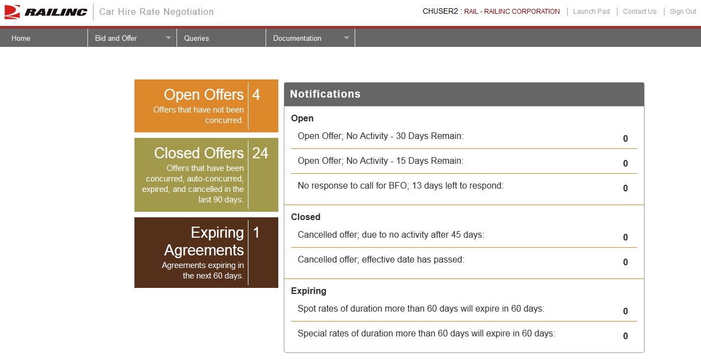
Bid and Offer Dashboard
Notes:
Ability to keep track of all bids and offers in a single dashboard is desired by all of the carriers with whom we had discussions.
A single access point for all open offers would allow the user to see which offers are pending their action as well as visibility into offers that they have sent to other users.
A bid and offer dashboard would also allow users a way to easily manage ticklers for open offers and search their offers by expiration date.
Users will be provided with a history of each negotiated rate, so that they can better keep track of the back and forth negotiations on a specific open offer

Slide 8
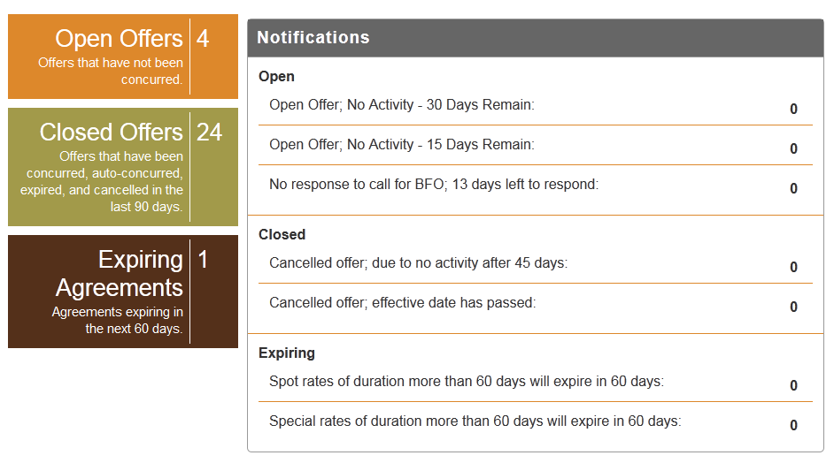
Open Offers
Notes:
Count of Open offers – not concurred

Slide 9
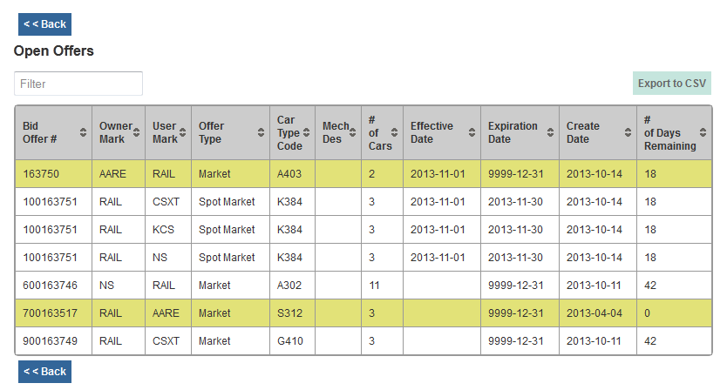
Open Offer Summary
Notes:
Open offer summary:
Filter – type in any test, i.e., car type code
Highlights offers that have a Call for BFO
No. of days remaining
No. of cars on offer
Click on columns to sort
Export list to CSV

Slide 10
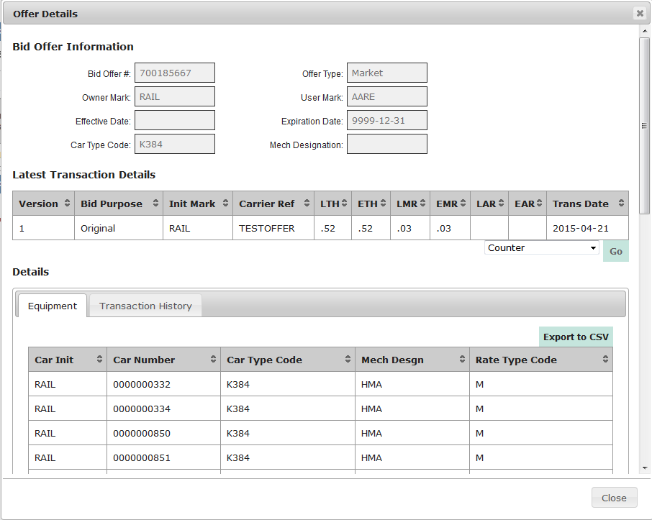
Open Offer Detail
Notes:
INSERT NEW SCREENSHOT
Open offer detail:
View offer details
Latest transaction details
Equipment list
Respond directly from offer detail
Export to CSV – equipment and transaction

Slide 11
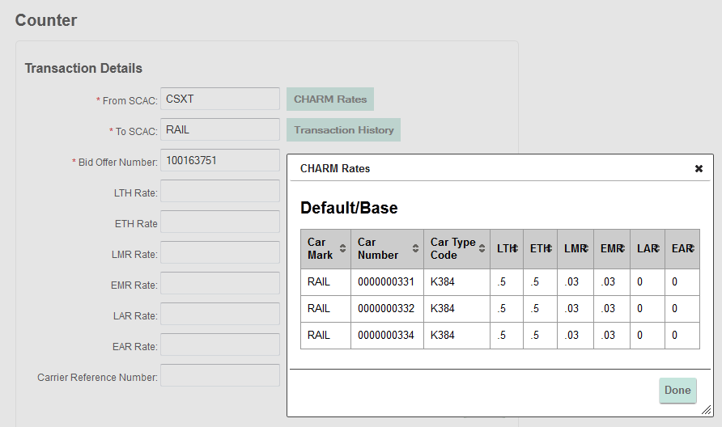
Respond to Open Offer
Notes:
When responding to an offer, user can view default rates

Slide 12
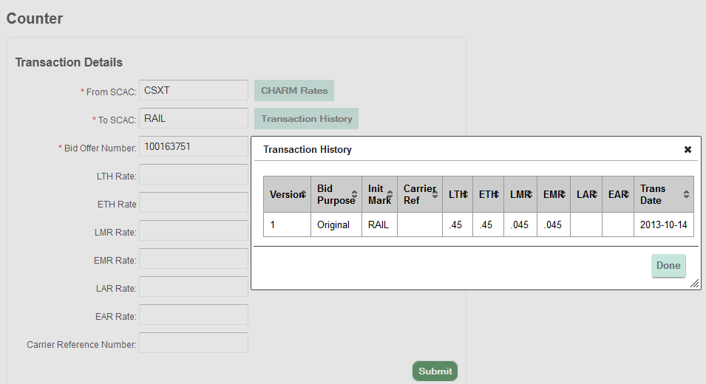
Respond to Open Offer
Notes:
When responding to an offer, user can view transaction history

Slide 13
Closed Offers
Notes:
Closed offers – last 90 days
Contains all offers activity whether concurred or not

Slide 14
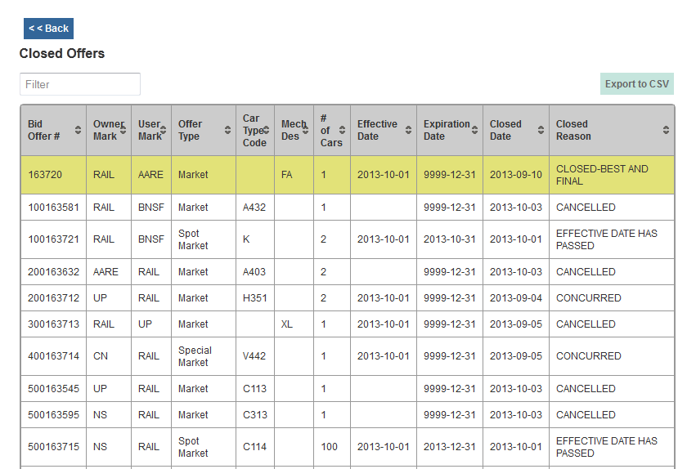
Closed Offers Summary
Notes:
Closed offer summary:
Filter – type in any test, i.e., car type code
Closed reason, i.e., concurred, cancelled, effective date passed
Highlights offers that have a Gone to BFO
No. of cars on offer
Click on columns to sort
Export list to CSV

Slide 15
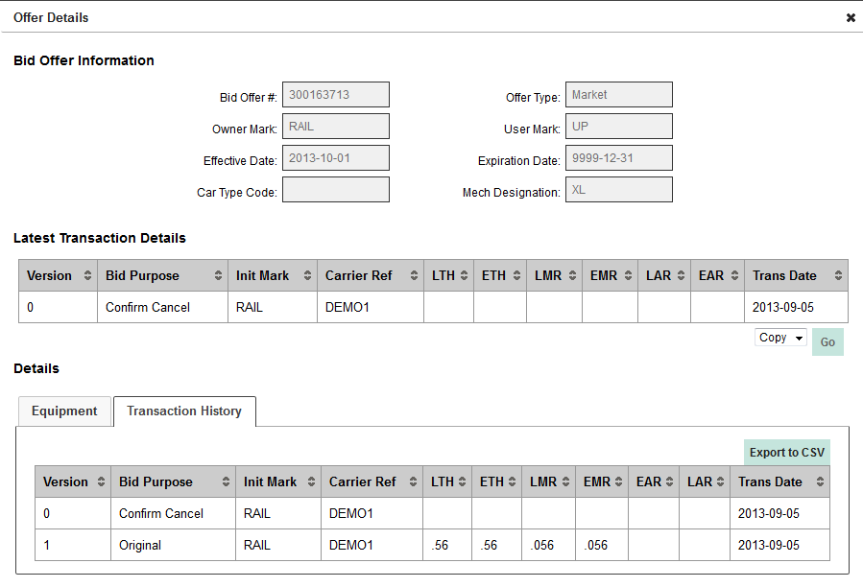
Copying a Closed Offer
Notes:
Can copy closed offer into new offer
Will copy offer type, details/rates, and equipment into new offer

Slide 16
Expiring Agreements

Slide 17
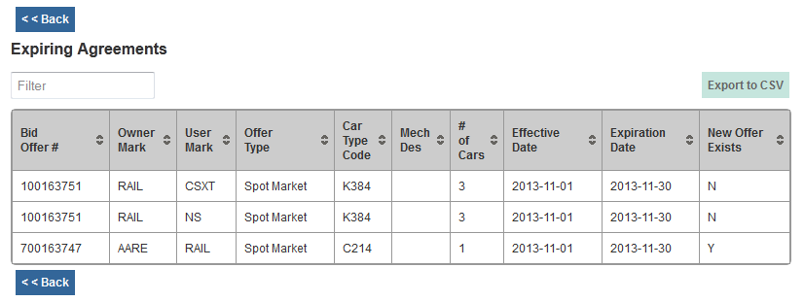
Expiring Agreements Summary
Notes:
Expiring agreements summary:
Effective and expiration dates
New offer exists – not in production until November release
Flag if new offer has been concurred – same bid type, owner/user, equipment
Filter – type in any test, i.e., car type code
Click on columns to sort
Export list to CSV

Slide 18
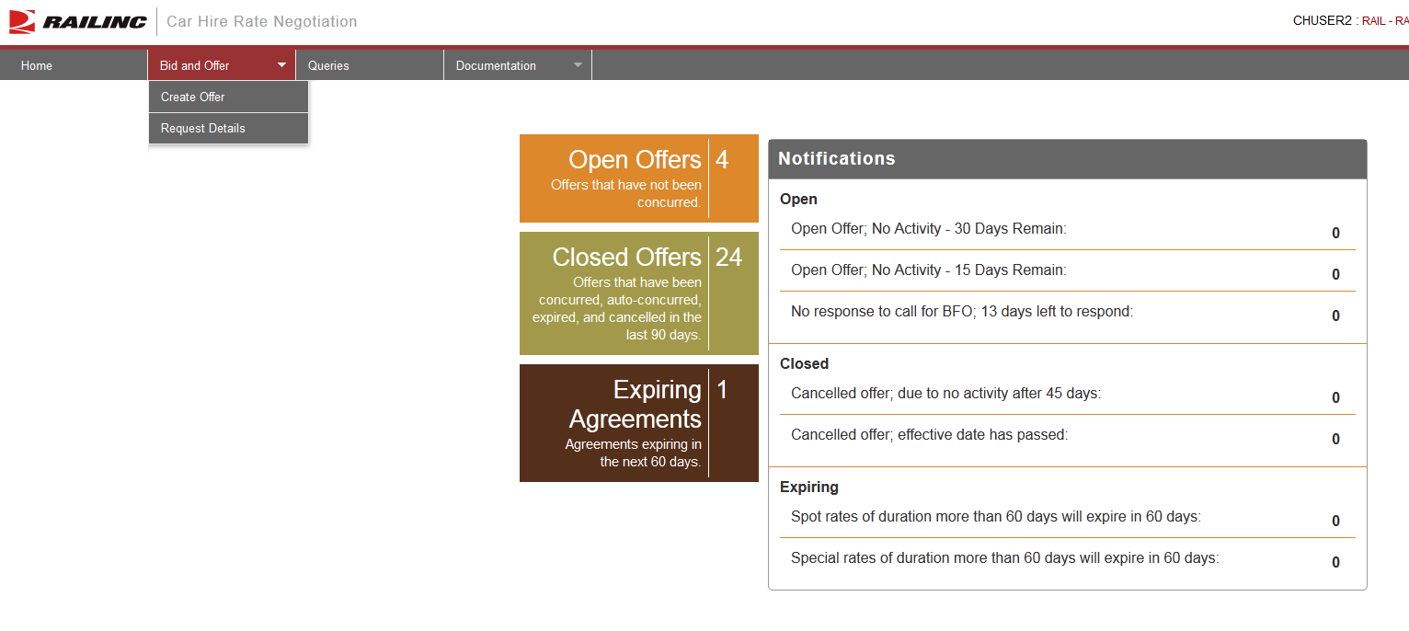
Creating a Bid/Offer
Notes:
Menu from home page
Create Offer
Request Detail – part of legacy system
Can receive email with detail of offer (not really used much anymore due to dashboard)

Slide 19
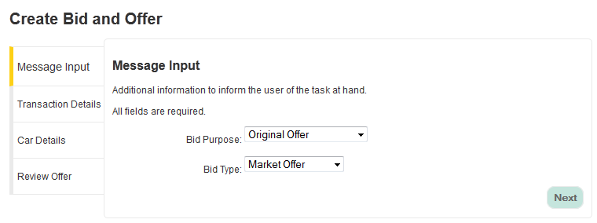
Select Bid Purpose and Bid Type
Notes:
Menu-driven
Cannot select invalid purpose and type combination

Slide 20
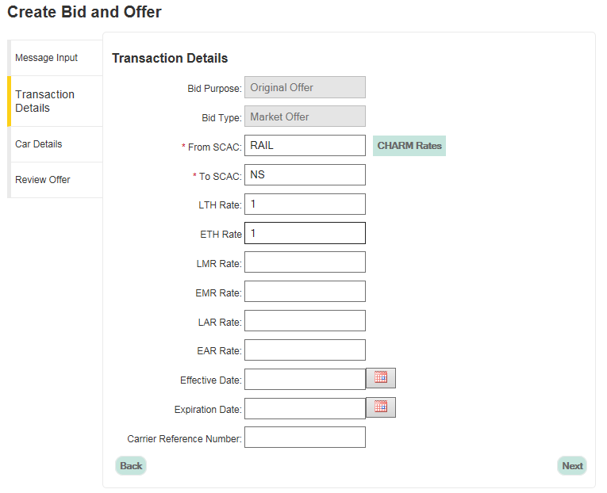
Transaction Details
Notes:
Input TO roads (single and multi)
Input rates (hourly, mileage, appurtenance)
* You are able to view CHARM rates once equipment has been added
Effective and Expirations dates
Calendar picker or enter in proper format
Carrier Ref Number (optional)

Slide 21
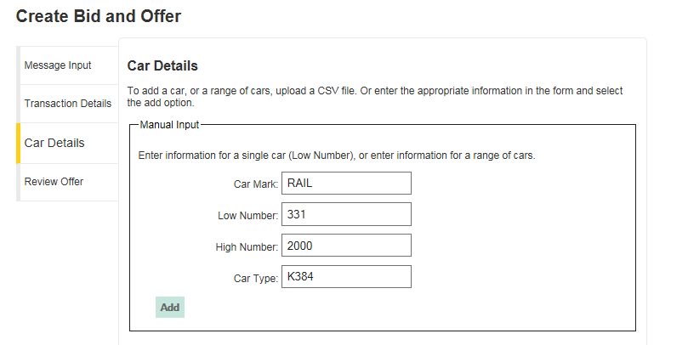
Car Details – Adding Equipment
Notes:
Upload a CSV or Manual Input
* Input single car or range
Equipment is validated for Umler registration and car type/mechanical designation
Recent – Oct-2014: Increase car limit from 1,500 to 10,000 when submitting offers

Slide 22
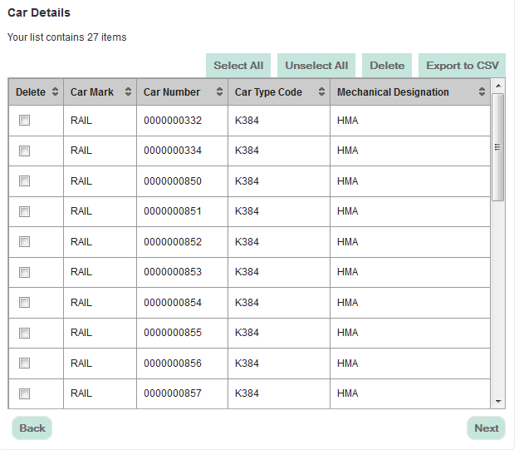
Car Details – Adding Equipment
Notes:
Car count
Can manually remove delete equipment from offer
Export to CSV

Slide 23
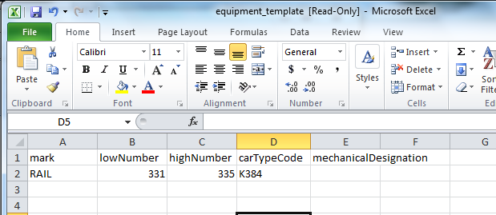
Car Details – CSV Upload
Notes:
Upload a CSV or Manual Input Template
Use CTC or Mech Desg
Equipment is validated for Umler registration and car type/mechanical designation

Slide 24
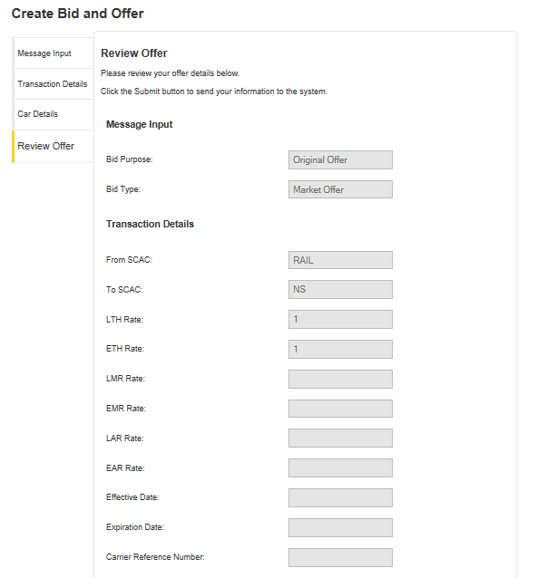
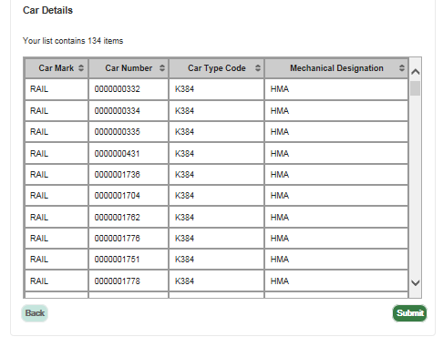
Review Offer
(cont’d)
Notes:
Review offer detail prior to submitting
Equipment is validated for Umler registration and car type/mechanical designation
Car detail window in review offer is also scrollable now

Slide 25
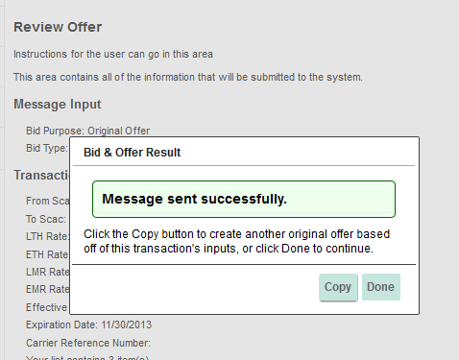
Submit Offer
Notes:
Copy offer to send to multiple roads
Proactive validations
Equipment on another offer
Non-market equipment on a market offer
Etc…
Ability to remove invalid equipment prior to submitting offer when creating a new offer
November release – equipment automatically removed; user can resubmit

Slide 26
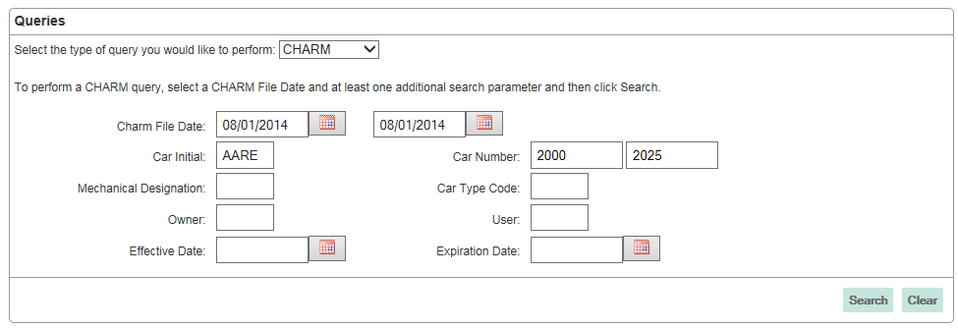
CHARM Query
Notes:
Query by CHARM file date and one other search parameter
CHARM can query 3 months at a time
Has at least 3 years of history

Slide 27
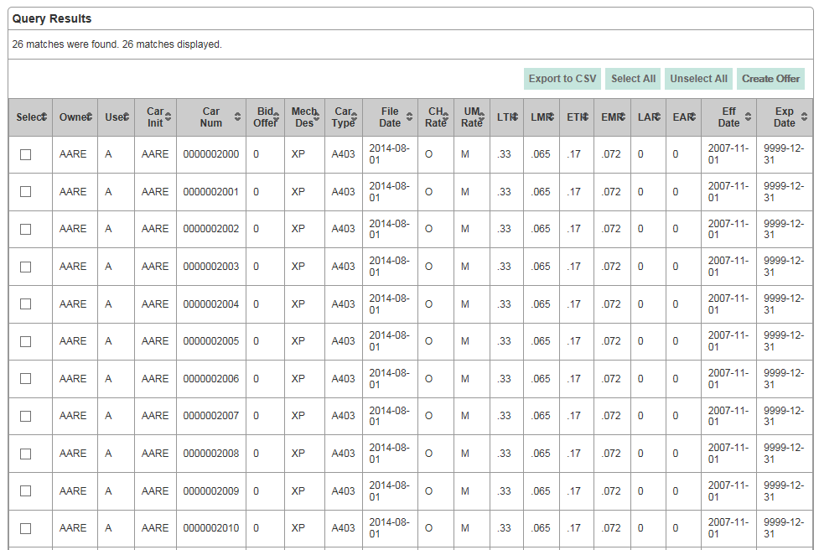
CHARM Results
Notes:
Can view 1500 on screen; export 5000

Slide 28
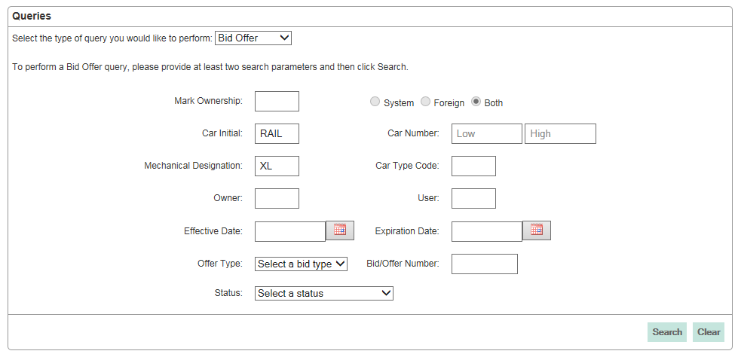
Bid/Offer Query
Notes:
Query by Bid offer history by at least two search parameters
Contains offers that have been concurred, cancelled, expired
Can view/export transaction detail for post-mainframe migration offers
View results at bid/offer summary vs. car detail

Slide 29
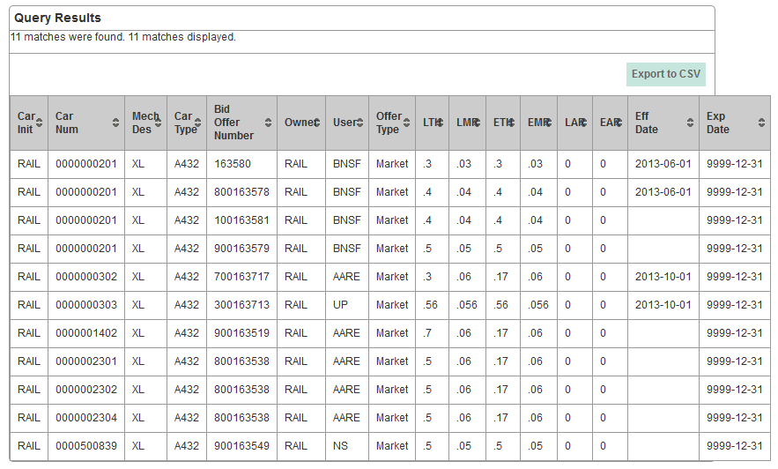
Bid/Offer Results
Notes:
Results View at equipment level
Can view 1500 and download up to 100,000
Clicking on a row will pull of transaction detail of offer
Columns can be sorted

Slide 30
What’s Next in 2015?
Continue with prioritized maintenance user stories/enhancements

Slide 31
Questions?

