Slide 1
ACACSO
WEB SITE
BALTIMORE, MD
May 7th thru May 9th

Slide 2
History of Communication

Slide 3
ACACSO WEB SITE
Survey says…
Current awareness of ACACSO website?
When did you last visit?
Purpose of visit?
Relationship to this meeting?

Slide 4
ACACSO WEB SITE
Purpose
“Say something – Do something”
Facilitate efficiency
Data repository
Current and accurate
Value – “Take Away”

Slide 5
Attributes of a Website
1
KEYWORDS
  Keyword selection
    Building blocks
    Location
  Establishes success or failure

Slide 6
Attributes of a Website
Simple
Design
SIMPLE
DESIGN
2
  Keep it simple
  Keep it professional
  Keep it related to Keywords
  Keep it easy on eyes

Slide 7
Attributes of a Website
3
Data
Integrity
  Current
  Accuracy
  Customer mindful

Slide 8
Attributes of a Website
4
Easy
Navigation
  Effortless and simple
  Points of references
  Audience friendly

Slide 9
Attributes of a Website
5
Value
  Why?
    Immediate source of information
    Present and historical repository
    Link capability
  Availability
    24 x 7

Slide 10
Attributes of ACACSO Website
Keywords
Simple
Design
Value
Data
Integrity
Easy
Navigation

Slide 11
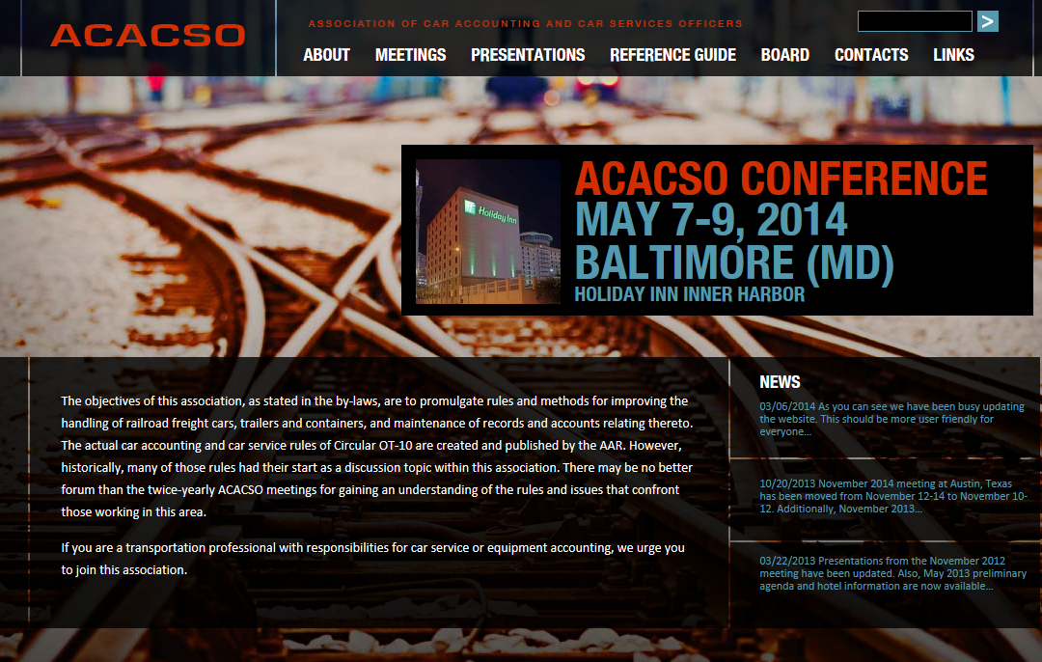
KEYWORD: “ABOUT”

Slide 12
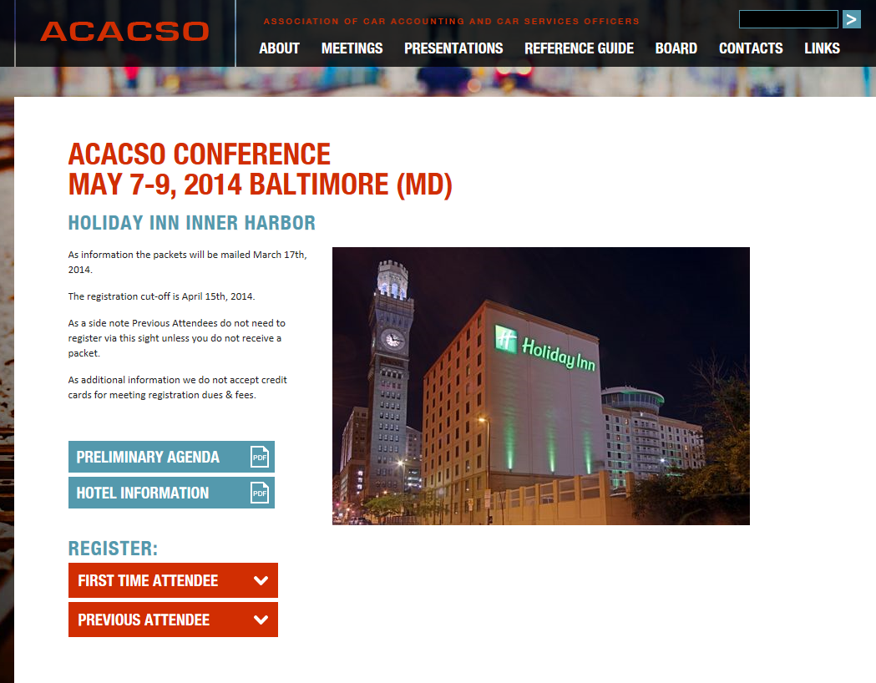
KEYWORD: “MEETINGS”

Slide 13
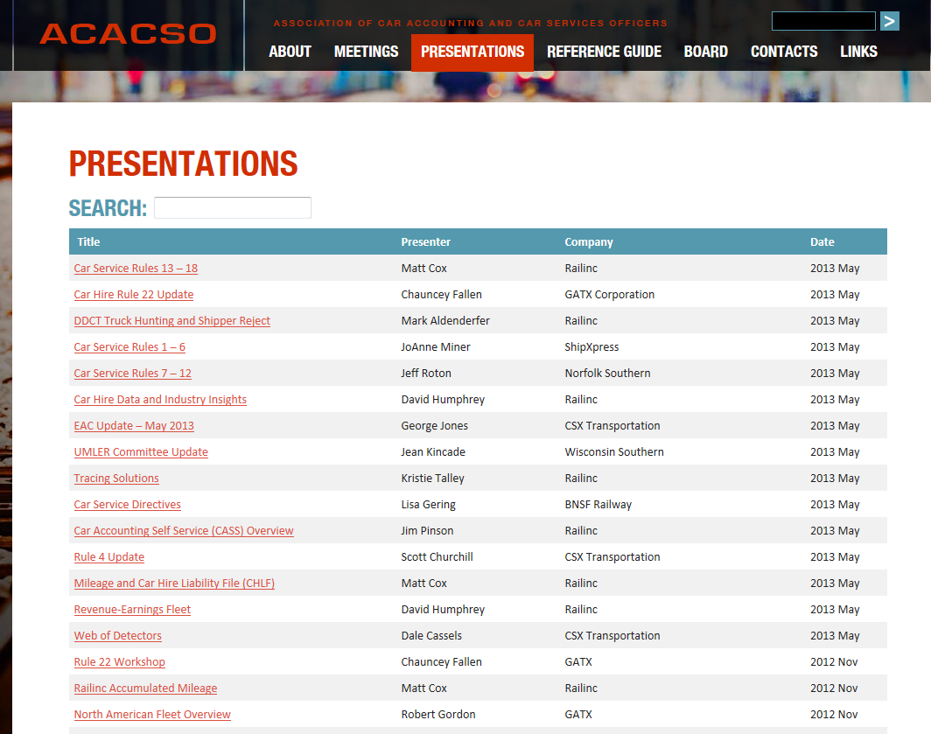
KEYWORD: “PRESENTATIONS”

Slide 14
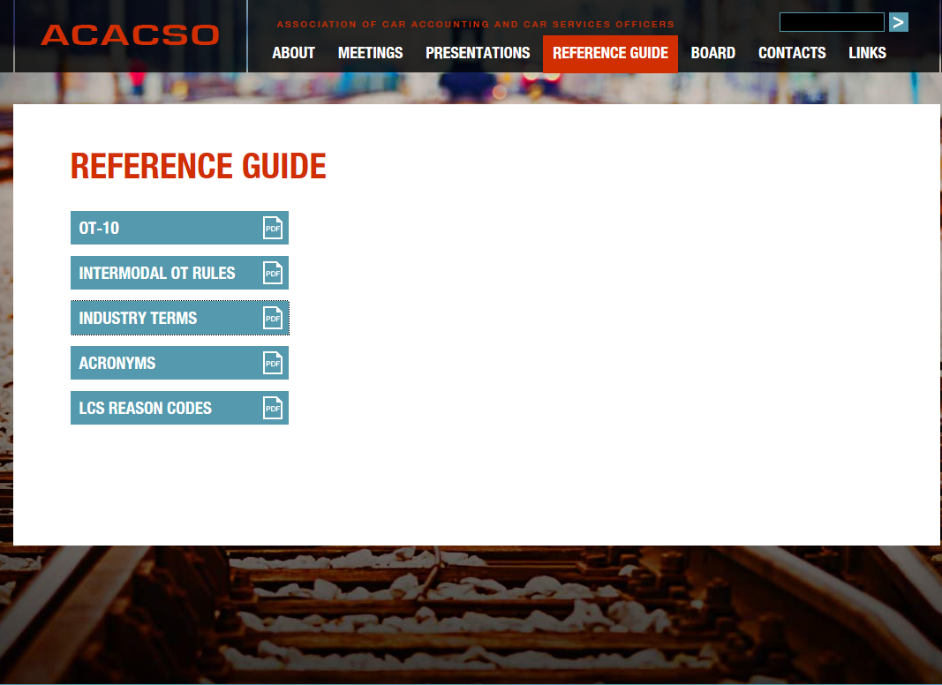
KEYWORD: “REFERENCE GUIDE”

Slide 15
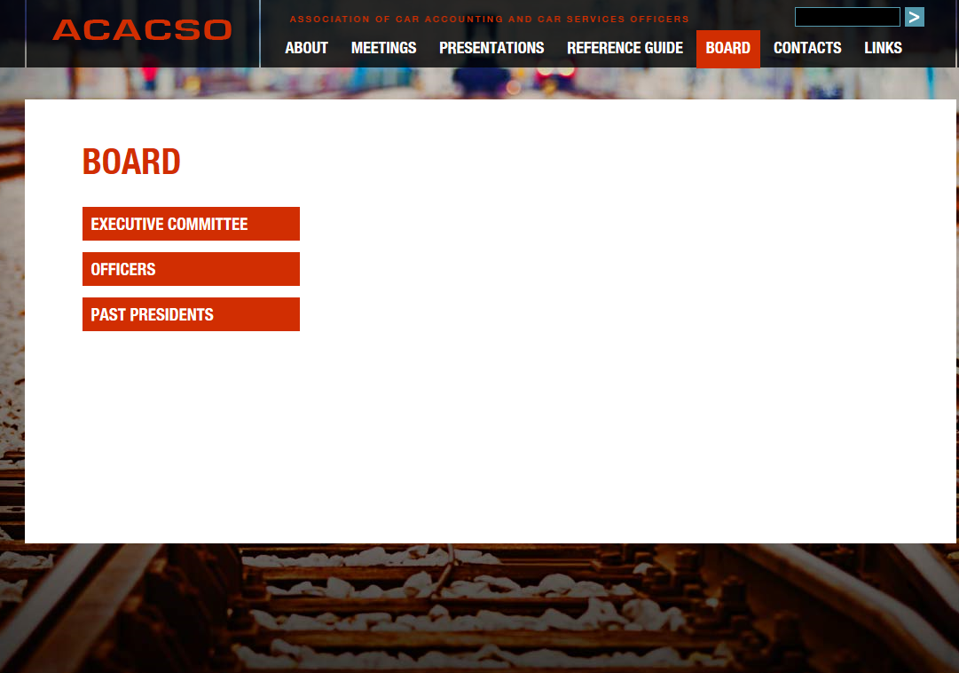
KEYWORD: “BOARD”

Slide 16
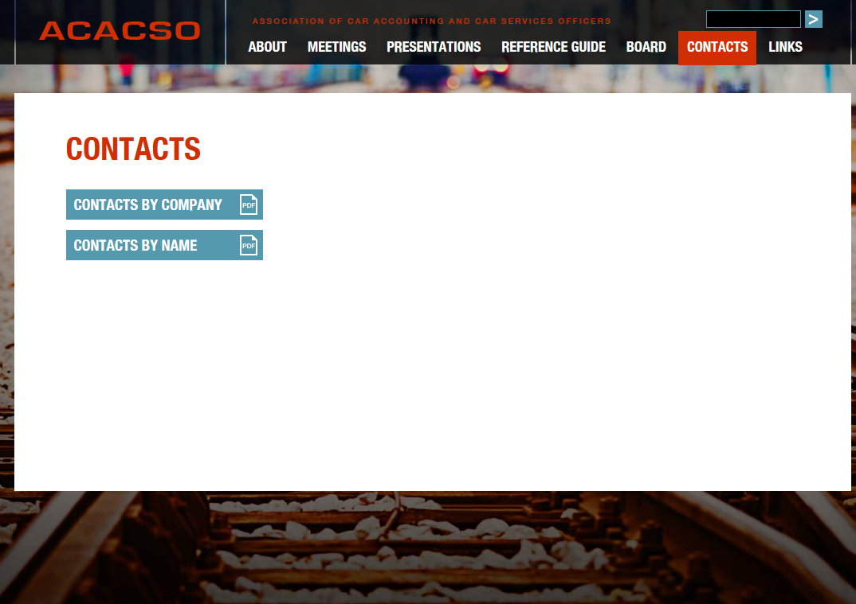
KEYWORD: “CONTACTS”

Slide 17
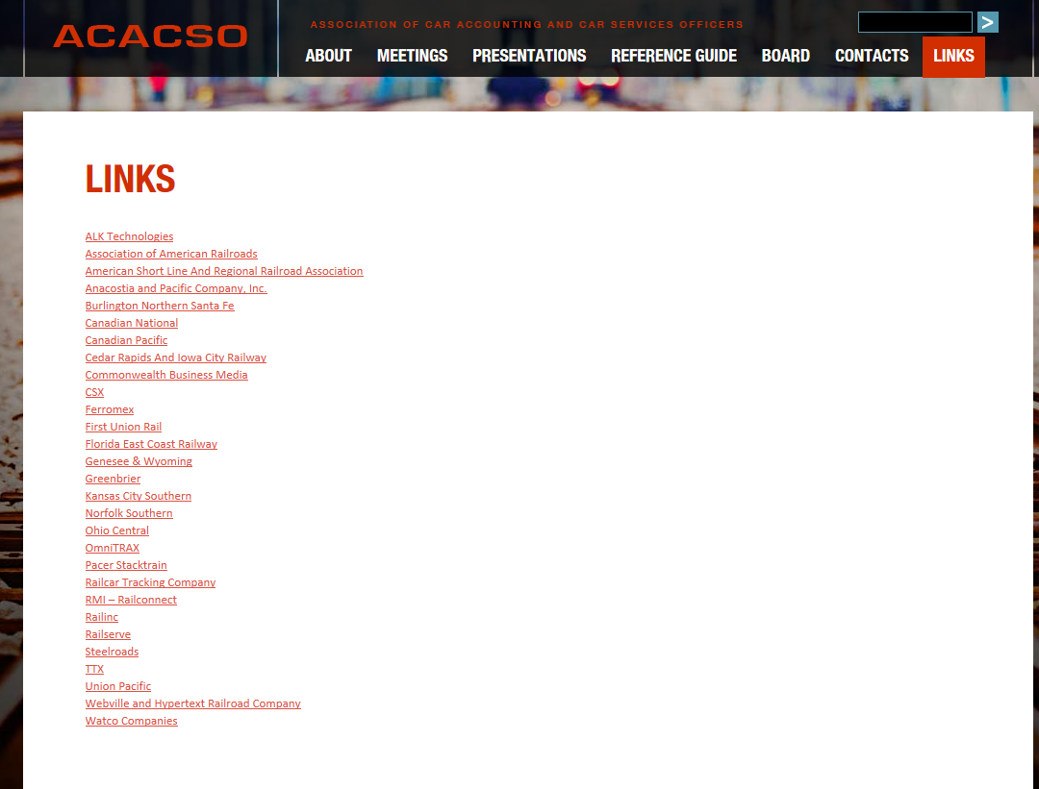
KEYWORD: “LINKS”

