Slide 1
CASS Car Accounting Self Service
ACACSO – May 8 – 10, 2013
Jim Pinson
Railinc

Slide 2
Discussion Topics
Overview of CASS
Accessing CASS
Retrieving Records
Examples
Liability Acceptance Message
Future Enhancements

Slide 3
Overview of CASS

Slide 4
Overview of CASS
Provides Access to Event Repository Data
Carrier Systems use Internal Records
LCS Analyzes Records from all Carriers
Car Movement
Interchanges
Transfers of Liability (Rule 15)
Understanding LCS Requires an Industry View of the Records

Slide 5
Overview of CASS
Getting the Industry View Prior to CASS
Contact Railinc and Explain the Need
Railinc Ran a SAS Query
Results Provided
Results Interpreted
Getting the Industry View Since CASS
Logon to CASS
Enter Equipment Number and Date
Press “Search”

Slide 6
Advantages to CASS
Ease of Use
Timeliness
Consistent Layout
Color Coding
Rule 5 TOL
Rule 15 TOL
Haulage
Suppression

Slide 7
Accessing CASS

Slide 8
Accessing CASS
Railinc Single Sign On Required
Access to the Application Required
Railinc Customer Support
877-724-5462
csc@railinc.com

Slide 9
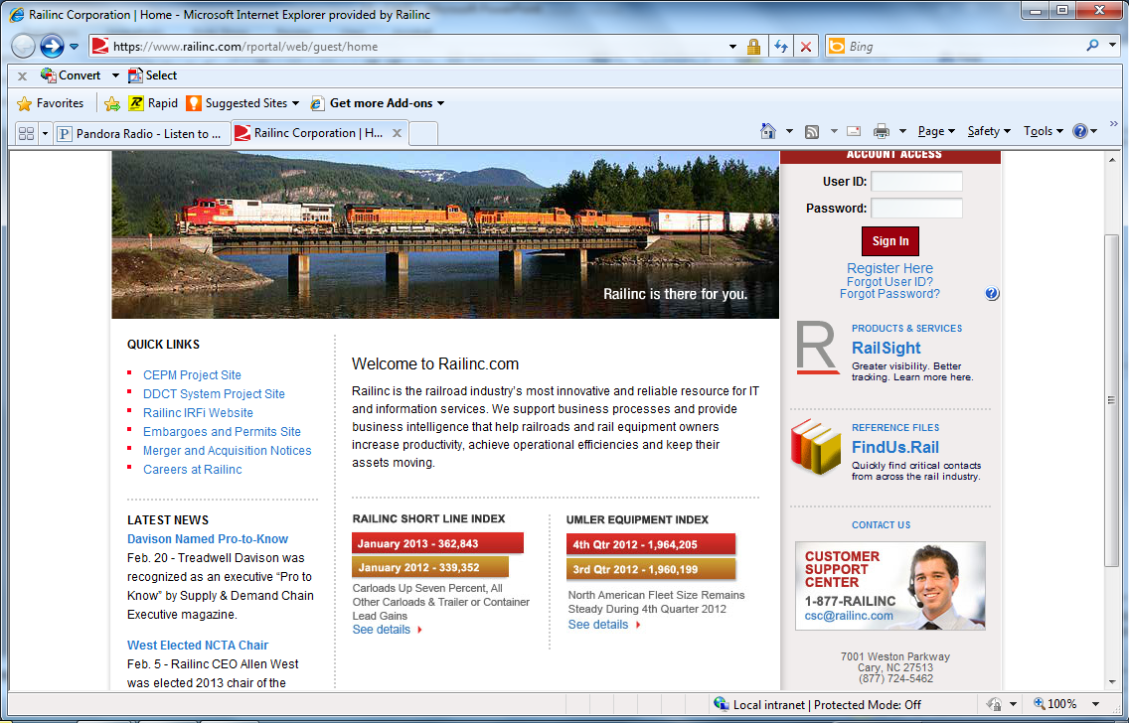
Reasons for Claims
Car hire was not calculated using interchange created by LCS
Car Hire Rule 9 requires use of LCS interchanges in car hire calculation
If record(s) other than LCS/TOL are used, the claim is due and should be allowed with 15 % penalty
Enter User ID and Password
Click “Sign In”
Notes:
Most claims are caused by a small number of errors.
Some claims are issued because LCS and TOL records were not used in calculating car hire liability. Car Hire Rule 9 requires the use of LCS records in the calculation of car hire liability. If records other than LCS interchanges and TOL messages are used in the determination of car hire liability, the claim is due and should be allowed with 15% penalty.

Slide 10
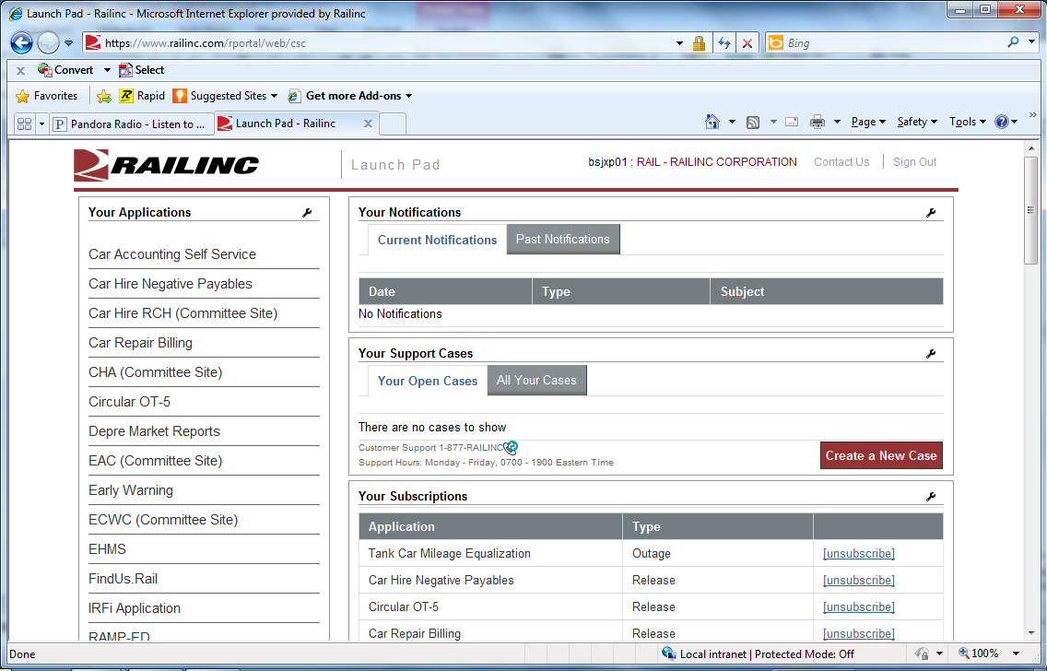
Reasons for Claims (cont'd)
An arrangement between interchange partners dictates that car hire be paid by another carrier
Bilateral arrangements should not reduce or delay payment to the car mark owner
Reclaims can be used to properly allocate car hire expense between the handling carriers
The claim should be paid with a 15% penalty
Click “Car Accounting Self Service”

Slide 11
Retrieving Records

Slide 12
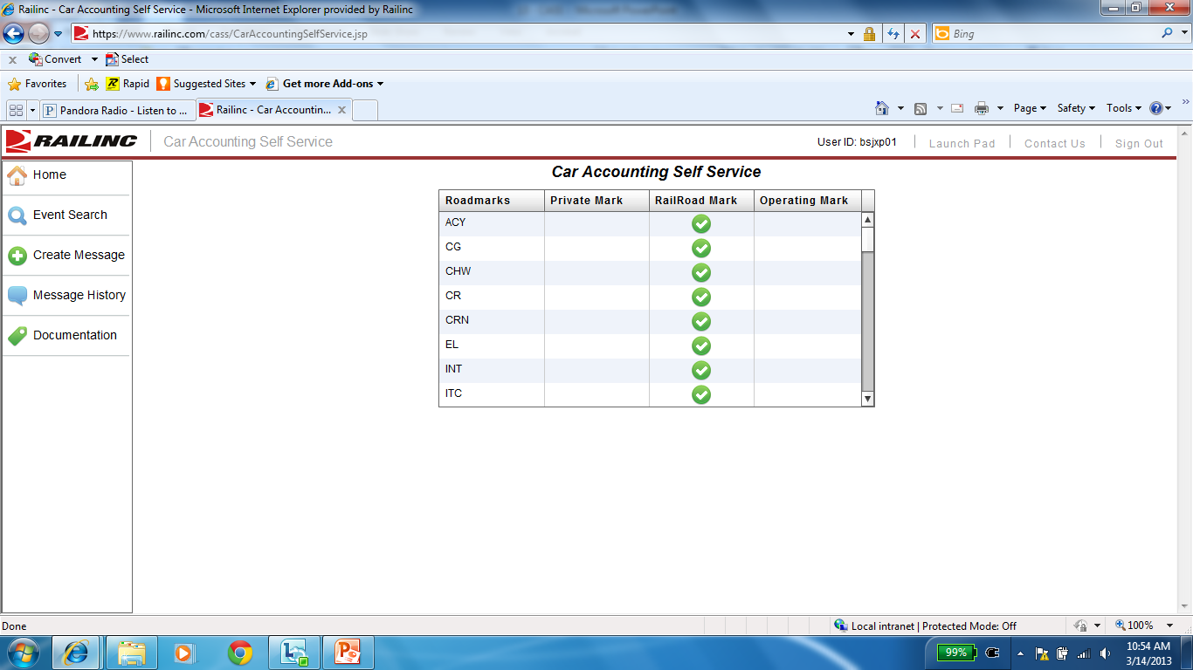
Select Event Search

Slide 13
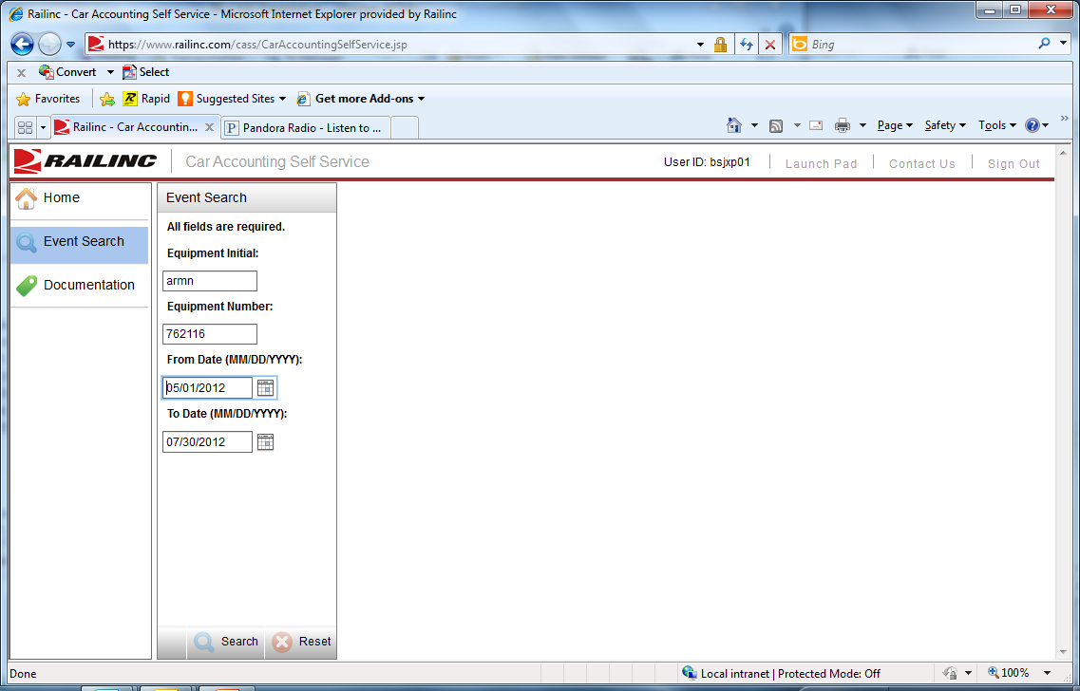
Reasons for Claims (cont'd)
Switching activity was not recognized
In order to decline a claim because of switching activity, a valid TOL must be supplied
In the absence of a TOL, car hire is owed to the car mark owner
Car hire and 15% penalty should be paid based on LCS and TOL records
Enter Car Initial ARMN
Enter Car Number 762116
Select From Date April 1, 2012
CASS will Select End Date
(90 Days after From Date)
Notes:
Discrepancies should be handled between the switching carrier and the line haul carrier outside the normal car hire/claim channels.
Claims caused by a failure to issue TOL messages should be paid with a 15% penalty.

Slide 14
Reasons for Claims (cont'd)
Switching activity was not recognized
In order to decline a claim because of switching activity, a valid TOL must be supplied
In the absence of a TOL, car hire is owed to the car mark owner
Car hire and 15% penalty should be paid based on LCS and TOL records
Click on “Search”
Notes:
Discrepancies should be handled between the switching carrier and the line haul carrier outside the normal car hire/claim channels.
Claims caused by a failure to issue TOL messages should be paid with a 15% penalty.

Slide 15
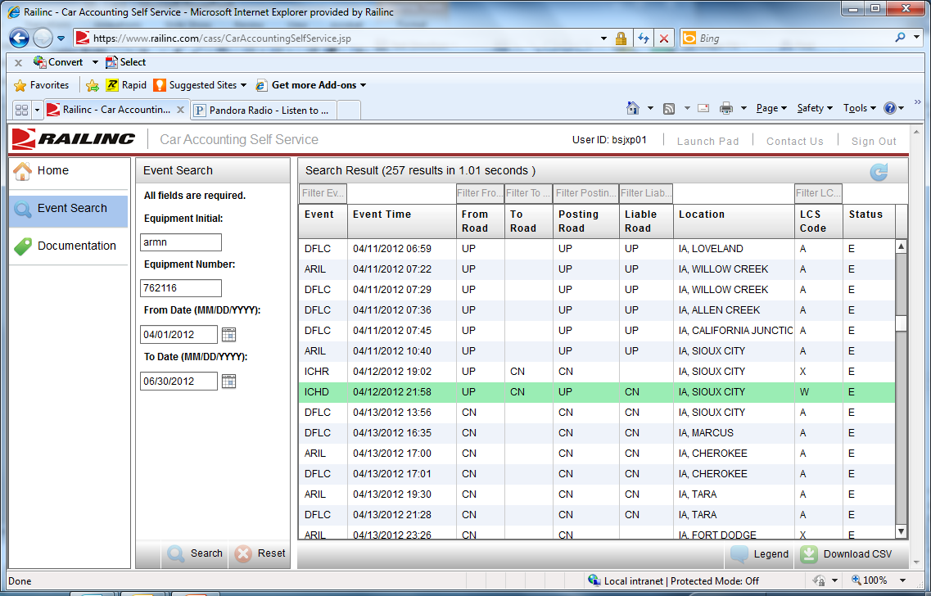
Responses to Claims
Claims can be declined because
Claim was issued outside time limits
LCS records place liability with another carrier
Can be verified using internal system or Railinc’s Car Accounting Self Serve (CASS) system accessed at www.railinc.com
Contact csc@railinc.com for information related to getting access
TOL records place the liability with another carrier
Claim that was issued is invalid
Events for ARMN 762116 from April 1 through June 30, 2012

Slide 16
Responses to Claims
Claims can be declined because
Claim was issued outside time limits
LCS records place liability with another carrier
Can be verified using internal system or Railinc’s Car Accounting Self Serve (CASS) system accessed at www.railinc.com
Contact csc@railinc.com for information related to getting access
TOL records place the liability with another carrier
Claim that was issued is invalid
One Record is Highlighted with Green
Click “Legend”

Slide 17
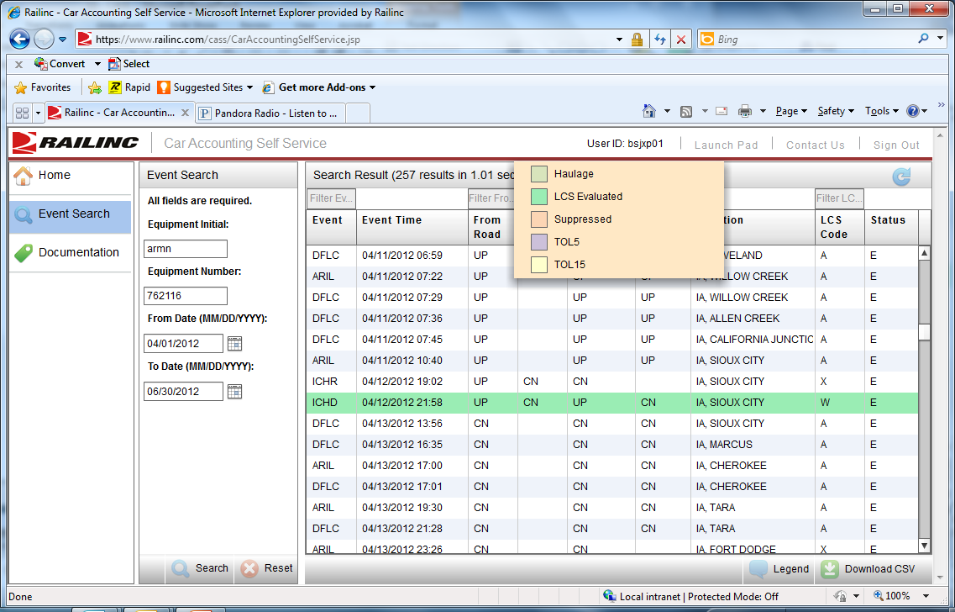
Responses to Claims (con’t)
Carriers receiving claims must pay any additional car hire owed – based on LCS records - with all resulting penalties
If roads don’t reply within timelines, carrier “buys” the claim and owes a 30% penalty
Green Highlight Means
“LCS Evaluated”

Slide 18
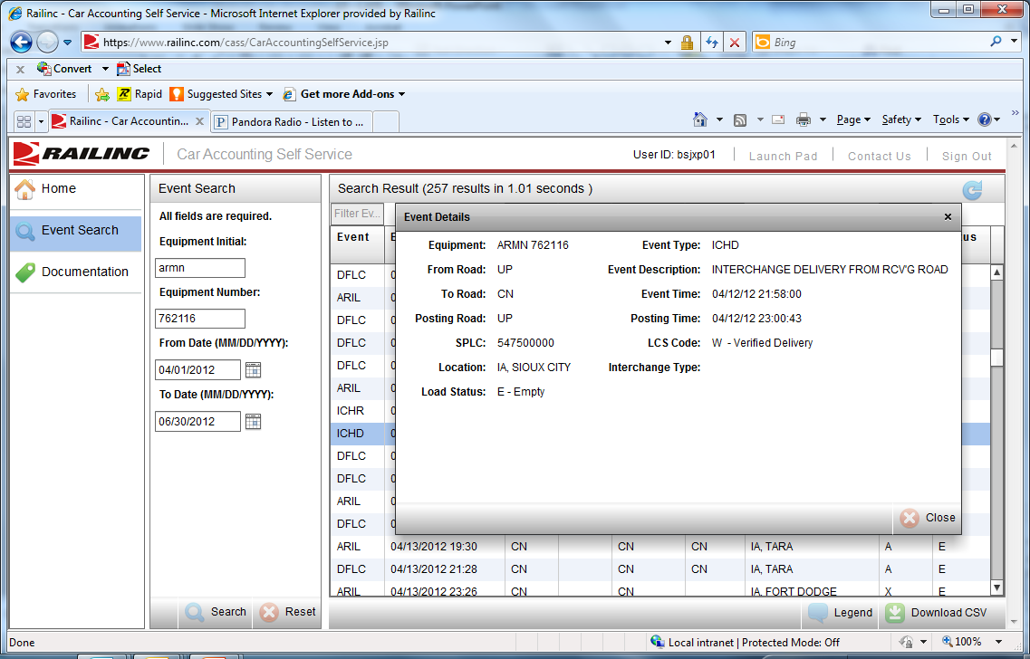
Double Click an Event for Additional Information

Slide 19
Responses to Claims (con’t)
Carriers receiving claims must pay any additional car hire owed – based on LCS records - with all resulting penalties
If roads don’t reply within timelines, carrier “buys” the claim and owes a 30% penalty
Green Highlight Means
“LCS Evaluated”
ICHR 4/12-19:02
ICHD 4/12-21:58
Difference Under 4 Hours
LCS Used the Delivery Date/Time

Slide 20
examples

Slide 21
Haulage

Slide 22
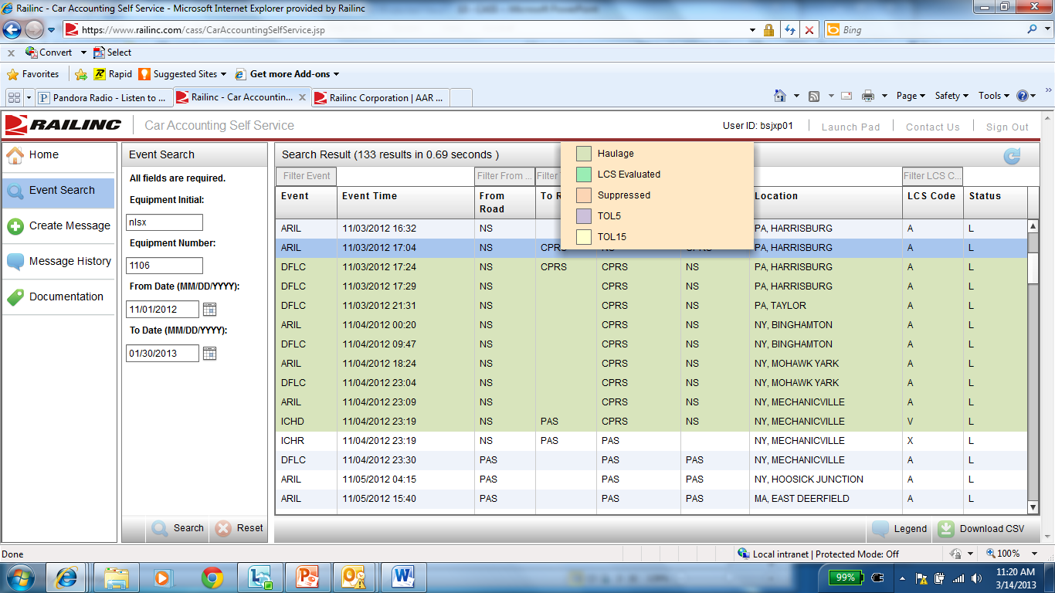
CASS Legend Shows Haulage

Slide 23
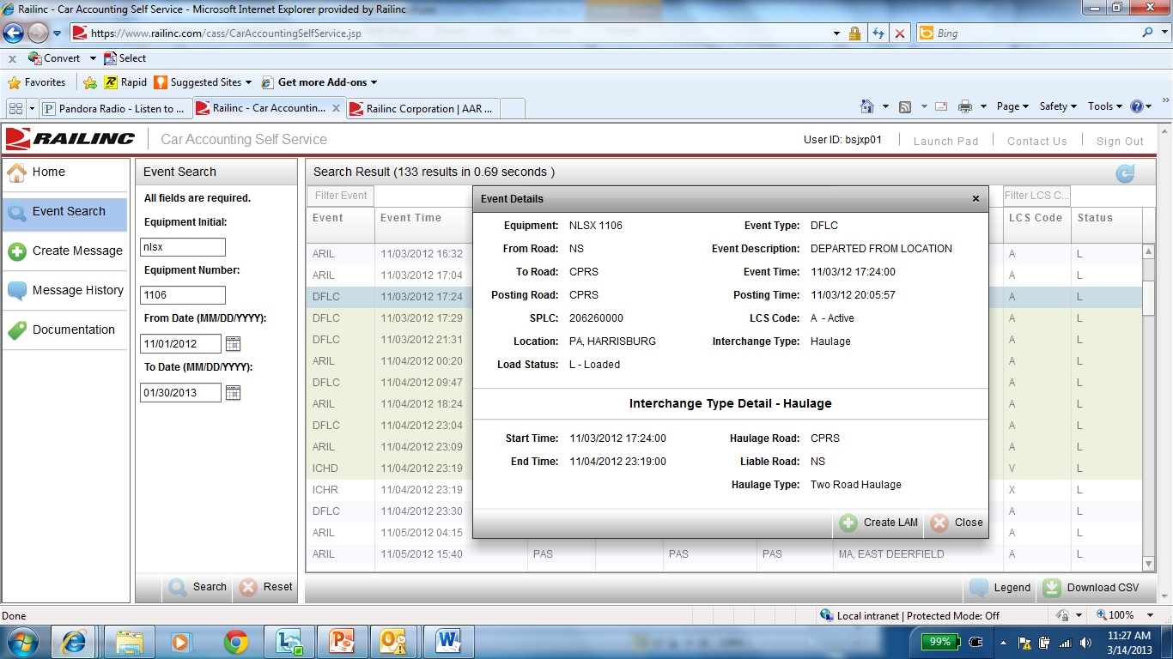
Double Clicking the 11/03 DFLC
Shows that the Event is a Haulage Interchange

Slide 24
Rule 5 TOL

Slide 25
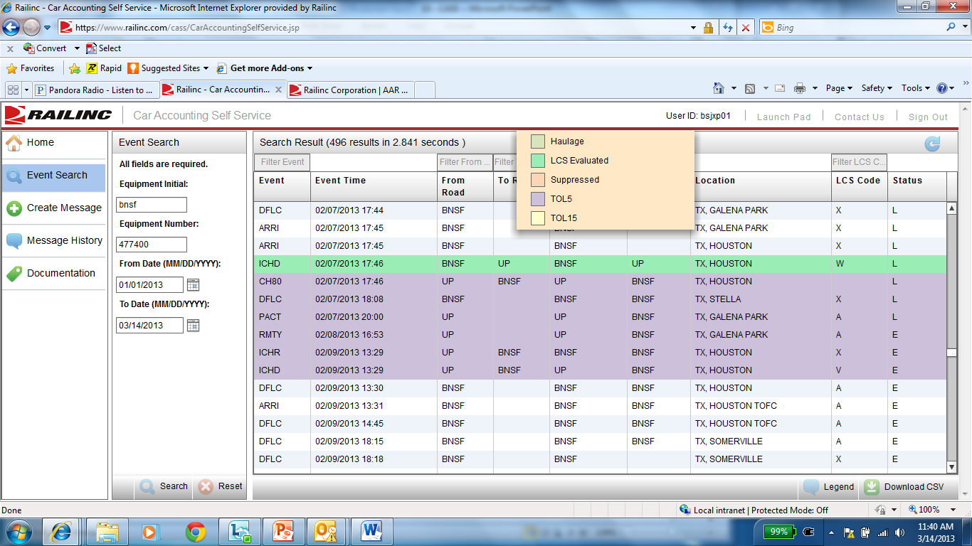
Cass Legend Shows Rule 5 TOL
BNSF – UP Interchange 2/7-17:46
TOL Message Moves Car Hire
Back to UP Accounts

Slide 26
Rule 15 TOL

Slide 27
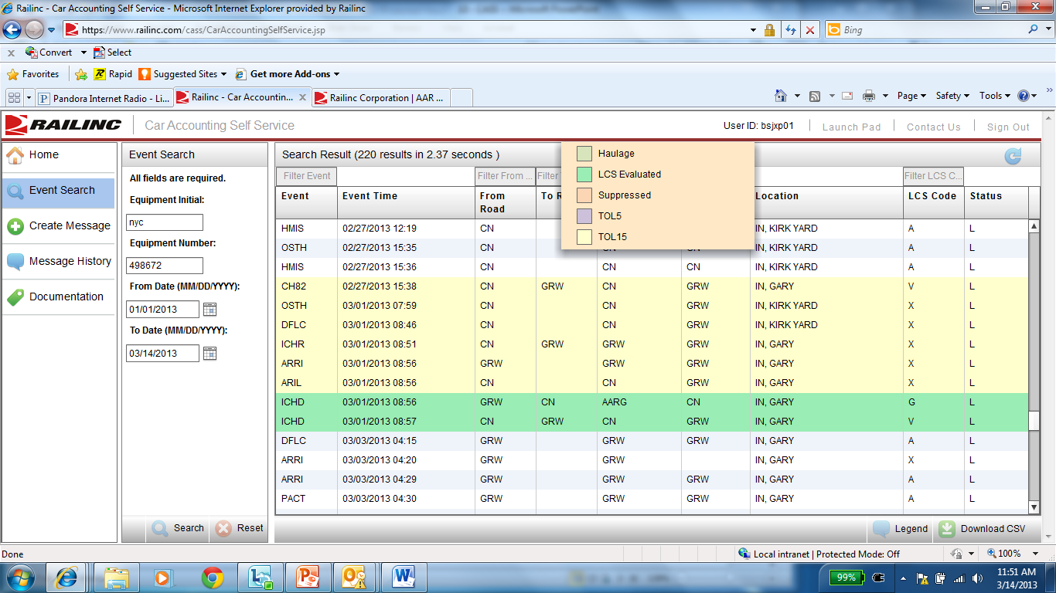
CASS Legend Shows Rule 15 TOL

Slide 28
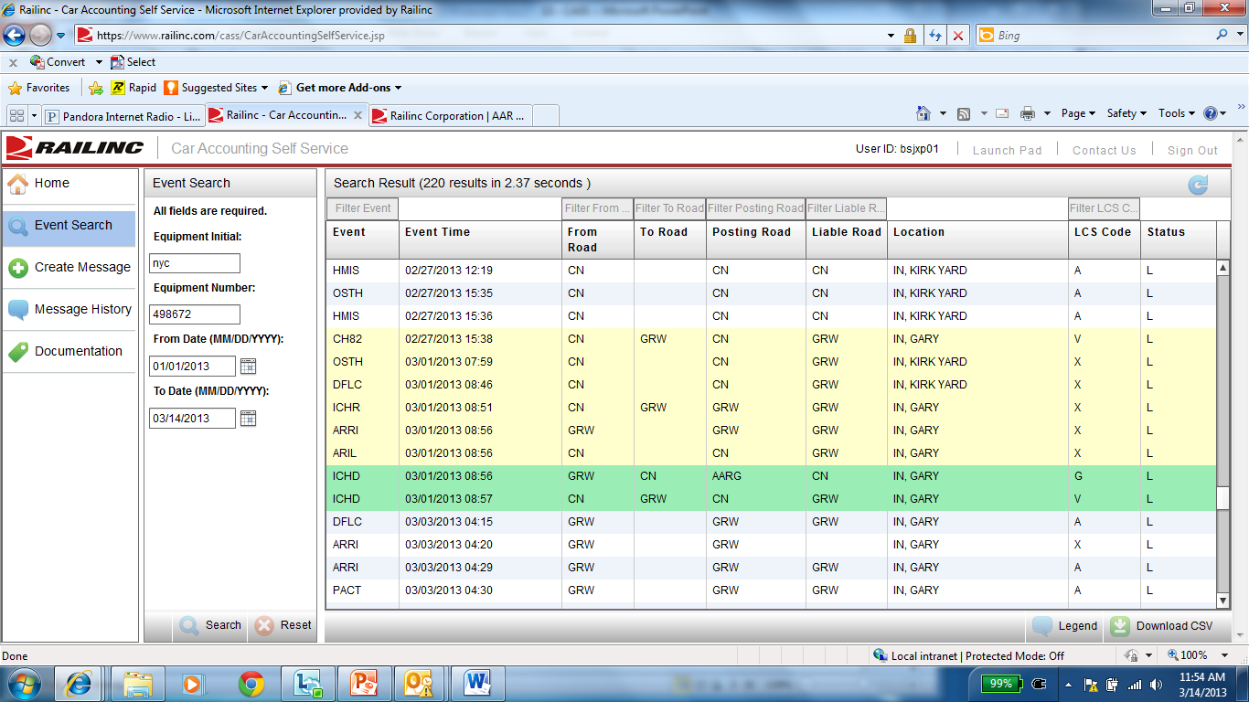
Rule 15 Message 2/17-15:38
Moved Car Hire to GRW Account
Physical Interchange 3/1-08:57
Gap Interchange Created by LCS to
End TOL 3/1-08:56

Slide 29
Suppressed Interchange

Slide 30
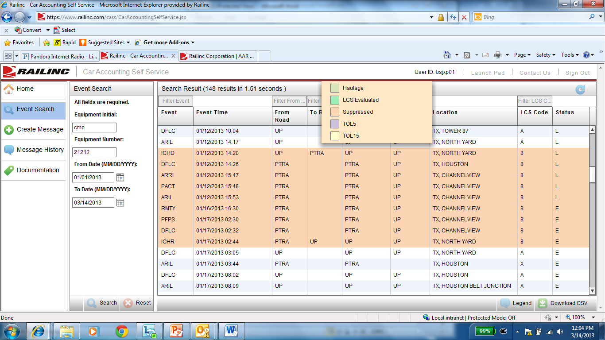
CASS Legend Show Suppressed Interchange
Interchange & Movements
Flagged as Suppressed

Slide 31
Liability Acceptance Message (LAM)

Slide 32
Description
LAM Allows Carriers to Accept Car Hire Liability Without Regard for LCS
Previously Called TRAIN 31 Type 5
Must be Created by the Carrier Receiving Liability
Special Authorization Required Within CASS

Slide 33
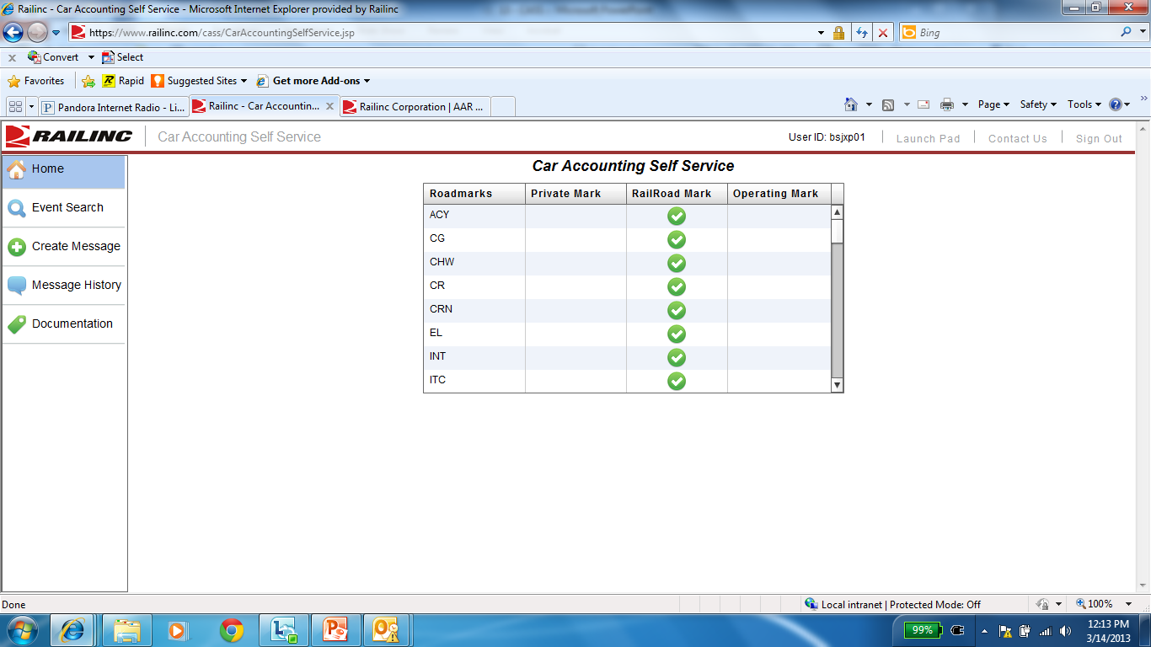
Select Create Message

Slide 34
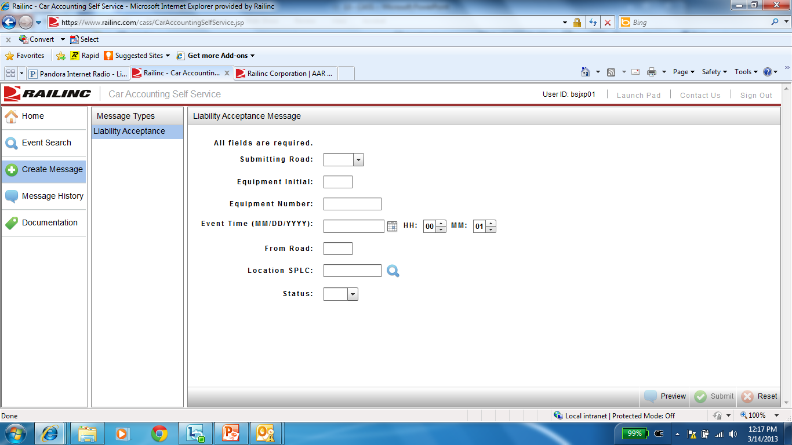
Enter Required Data:
Submitting Road
Equipment Initial
Equipment Number
Event Date/Time
From Road
Location SPLC
L/E Status

Slide 35
Future Enhancements

Slide 36
Future Enhancements
Display Registered Haulage Agreements
Display Cars Interchanged to DEAD
Display Registered TOL Agreements

Slide 37
Questions?
Railinc Customer Support Center: 877-724-5462
Jim Pinson: 919-651-5047

